Slide 1
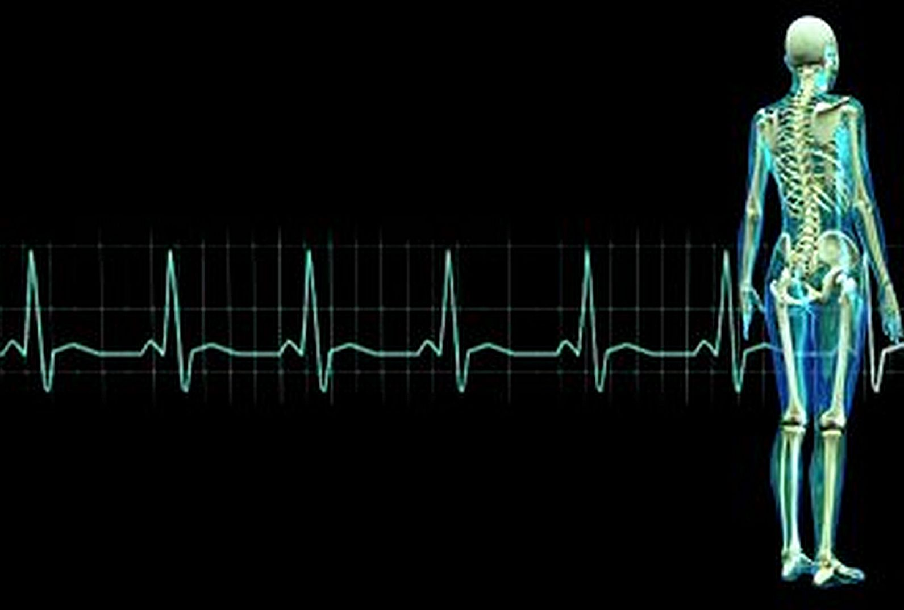
BSM System Health +
Mike Hollis
HP Software
Notes:
[TEMPLATE COMMENT]
Premier Advisory: Remove ‘/ Business’
Premier Business: Remove ‘Technical /’
Update ‘Q1 – 20xx’ to match the contract quarter and year
Update [CUSTOMER] with customer name
Update ‘Speaker’s name’ and ‘Month day’ of presentation
If available, place customer logo below the HP logo
Template NOTE: Graphs in this template is based on CSR report file version: Customer_Summary-2.0.4 SM9.xlsm created 31st October 2012
No Premier Specific changes have been made to the file
[REMOVE COMMENT]
The information contained herein is subject to change without notice. Certain restrictions may apply based on locality, product and service offering. The only warranties for HP products and services are set forth in the express warranty statements accompanying such products and services. Nothing herein should be construed as constituting an additional warranty. HP shall not be liable for technical or editorial errors or omissions contained herein.

Slide 2
Why System Health?
Stop and Start all BSM Services from one place
Failover to backup DPS using a GUI rather than the JMX console
Proactively monitor whether BSM/OMi is working correctly
Analyze BSM/OMi log files for a defined timeframe

Slide 3
System Health Facts
System Health is FREE!
    System Health has no license cost if you are a BSM/OMi user
System Health is a GREAT TROUBLESHOOTING AIDE!
    System Health is the BEST way to isolate problems in the BSM/OMi system
System Health is a BSM/OMi MONITOR
    System Health is the BEST way to monitor BSM/OMi

Slide 4
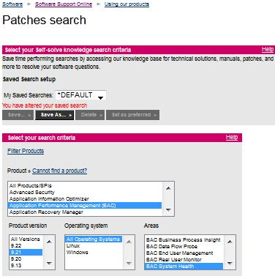
System Health Facts
Is System Health Part of SiteScope or BSM?
  BAC 8, BSM 9.0, BSM 9.1 – System Health is a SiteScope Install (install SiteScope and select System Health
  BSM 9.2x – System Health is an independent install (BAC patch)

Slide 5
System Health Facts
Integration with BSM/OMi - Use identical versions of System Health as your version of BSM/OMi:
  System Health 9.21 integrates with BSM/OMi 9.21
  System Health 9.22 integrates to BSM/OMi 9.22

Slide 6
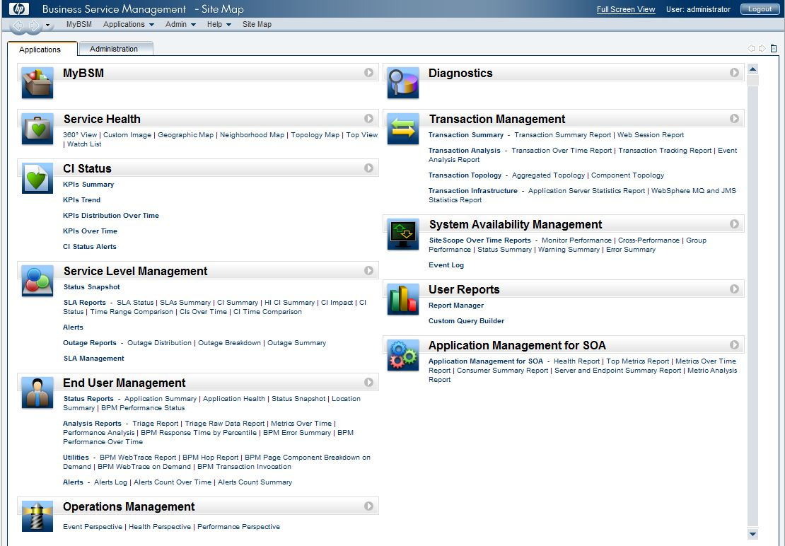
Installation – First Install and Start BSM/OMi

Slide 7
Installation – System Health Installation Options
Install on BSM/OMi Gateway Server
  Not as desirable – If physical Gateway Server goes down, you lose both part of BSM/OMi and your monitoring of BSM/OMi
Install on Independent Server
  Preferred Option – Gateway Server can go down, but your monitoring of BSM/OMi continues to inform and alert

Slide 8
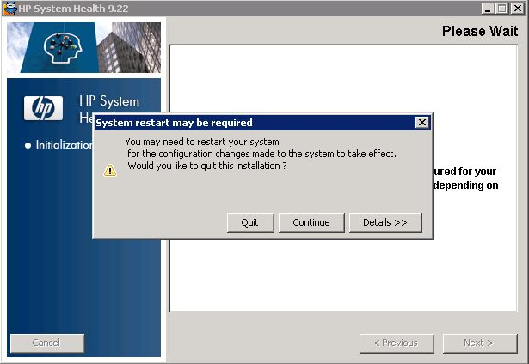
Installation – System Health Installer

Slide 9
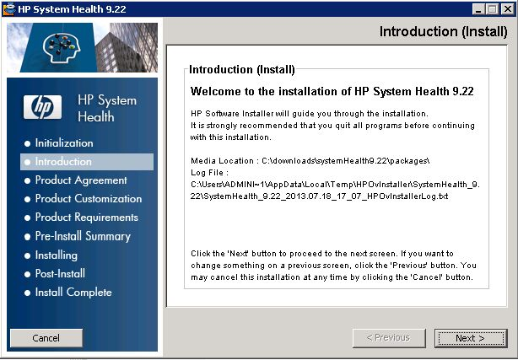
Installation – System Health Installer

Slide 10
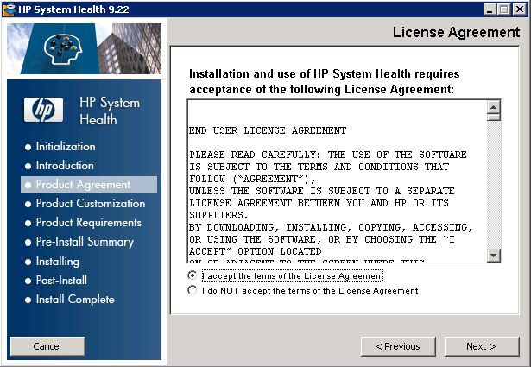
Installation – System Health Installer

Slide 11
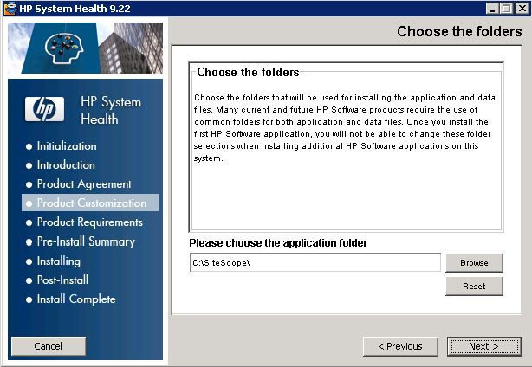
Installation – System Health Installer

Slide 12
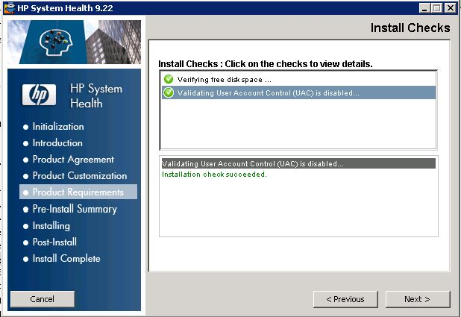
Installation – System Health Installer

Slide 13
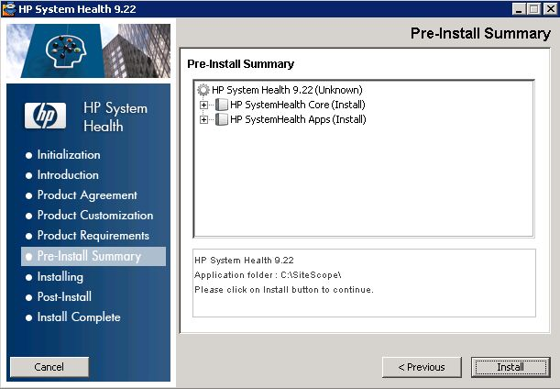
Installation – System Health Installer

Slide 14
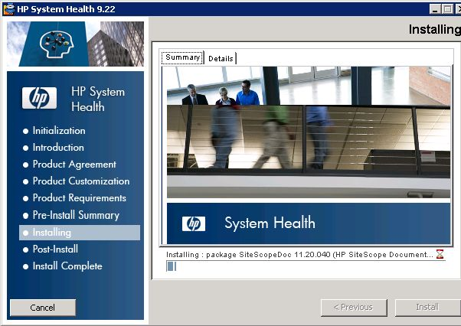
Installation – System Health Installer

Slide 15
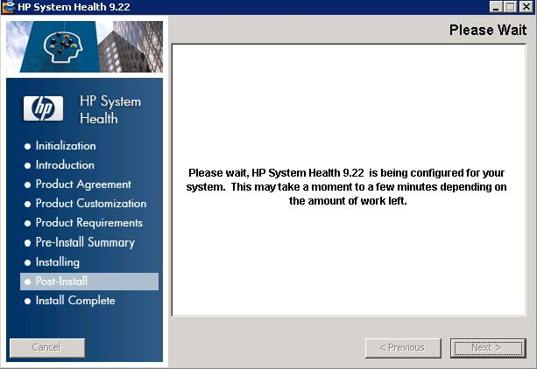
Installation – System Health Installer

Slide 16
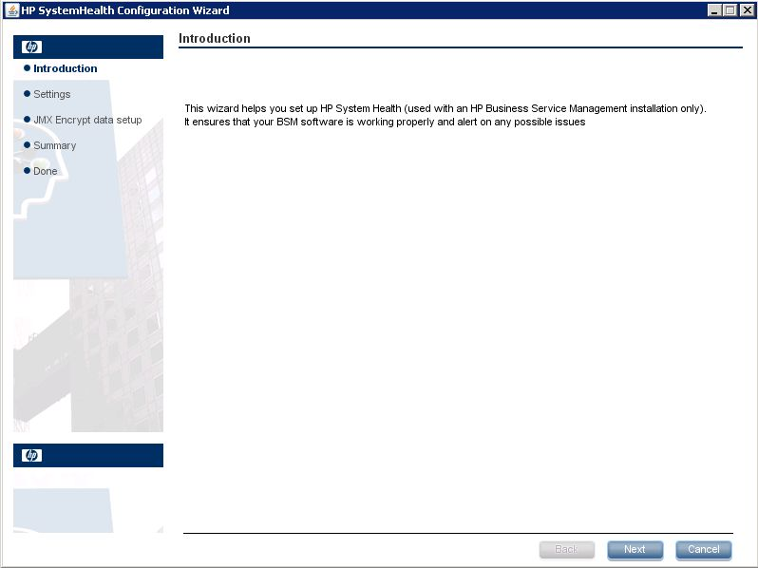
Installation – System Health Configuration Wizard

Slide 17
Installation – System Health Configuration Wizard

Slide 18
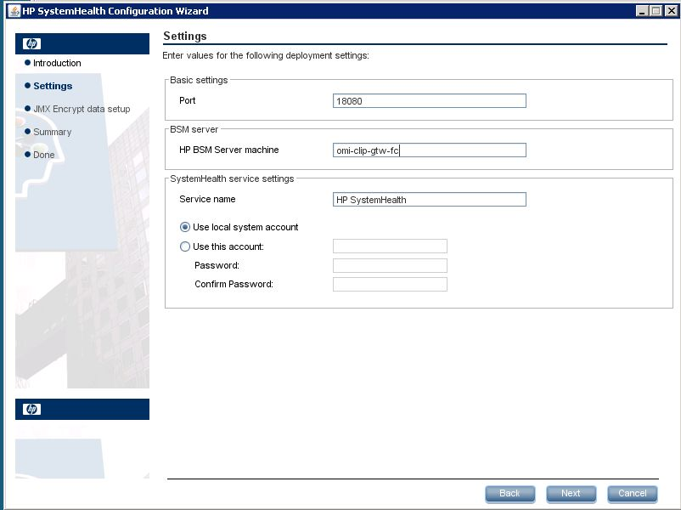
Installation – System Health Configuration Wizard

Slide 19
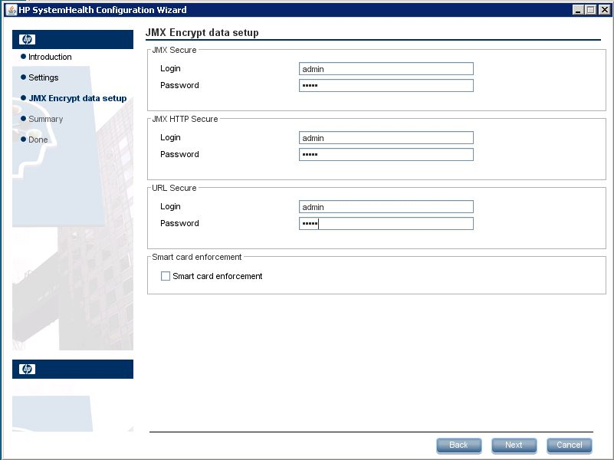
Installation – System Health Configuration Wizard

Slide 20
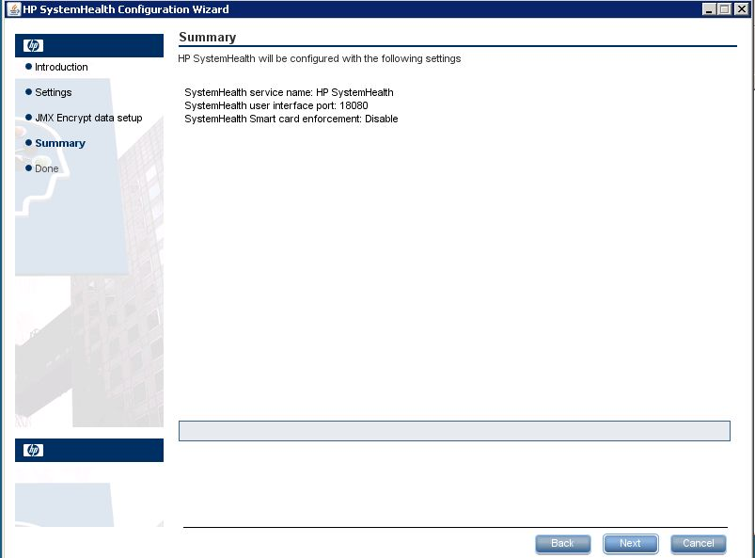
Installation – System Health Configuration Wizard

Slide 21
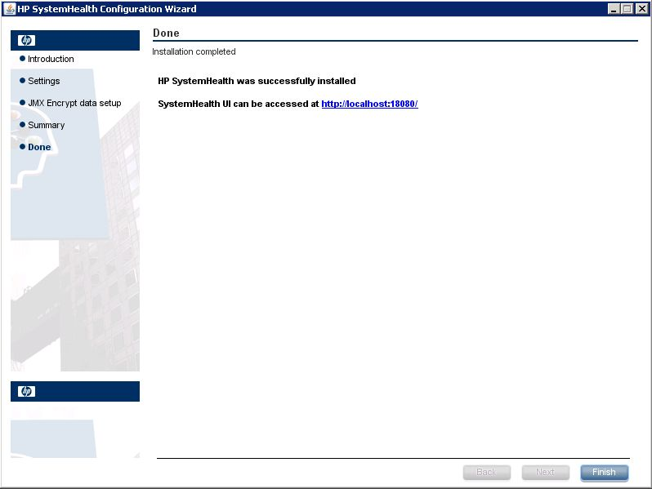
Installation – System Health Configuration Wizard

Slide 22
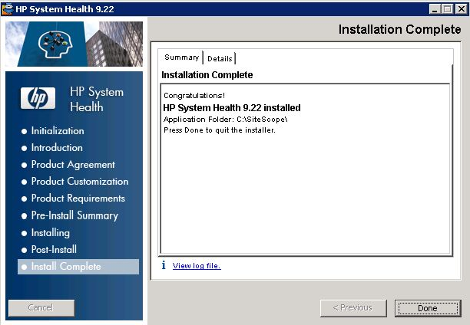
Installation – System Health Installer

Slide 23
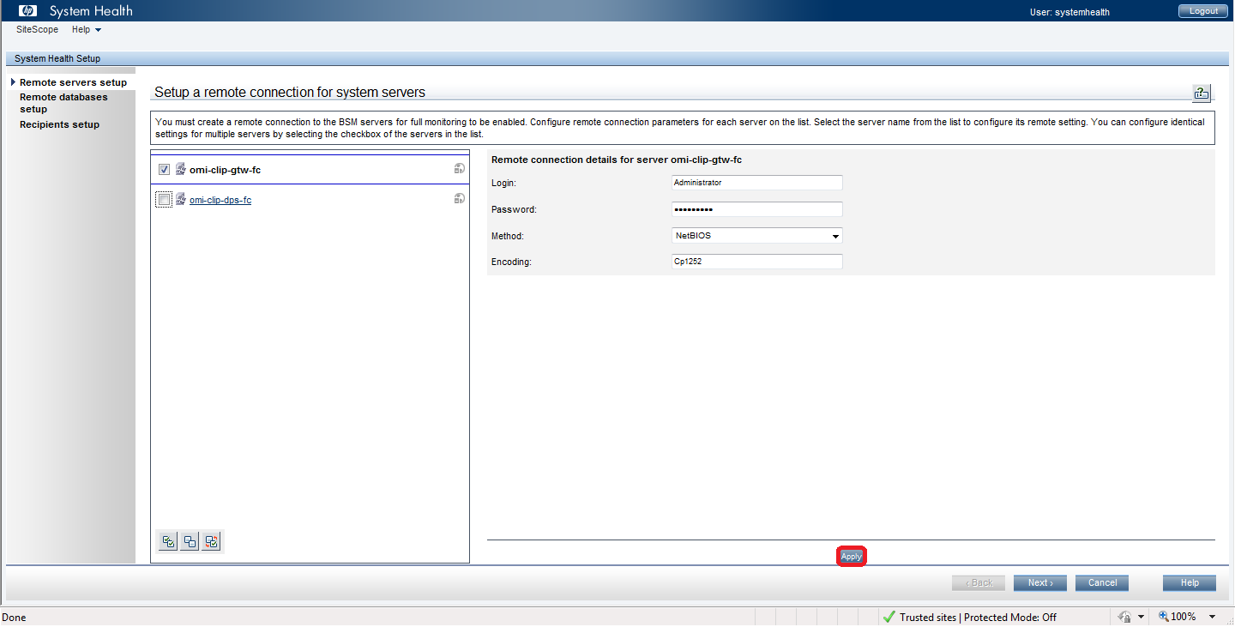
Installation – System Health Setup

Slide 24
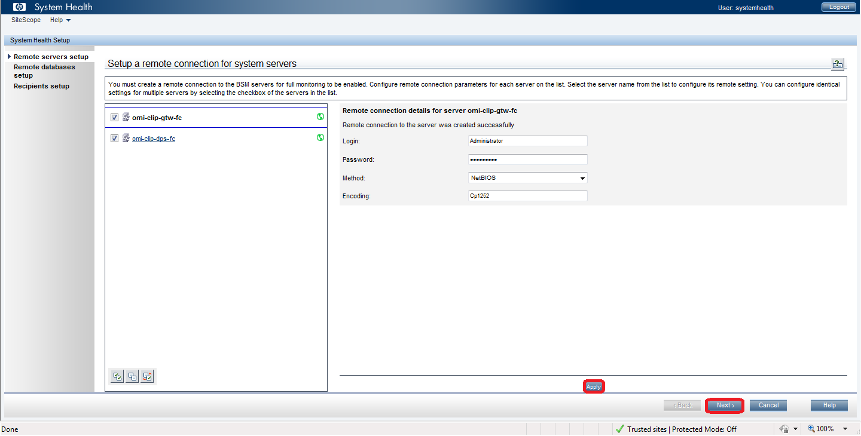
Installation – System Health Setup

Slide 25
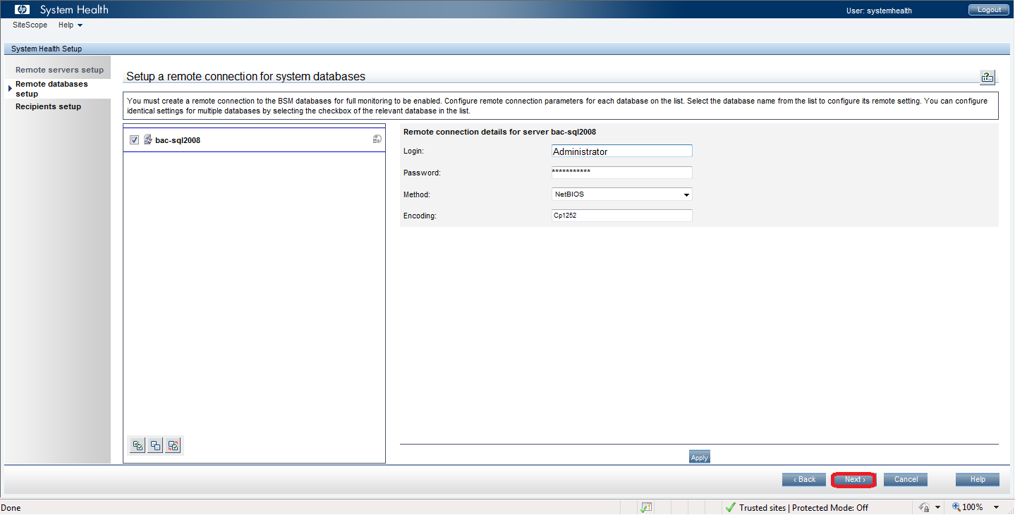
Installation – System Health Setup

Slide 26
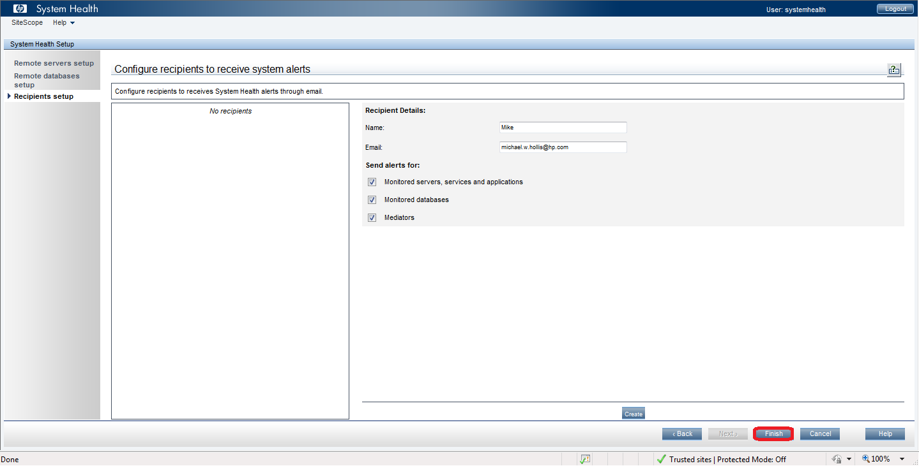
Installation – System Health Setup

Slide 27
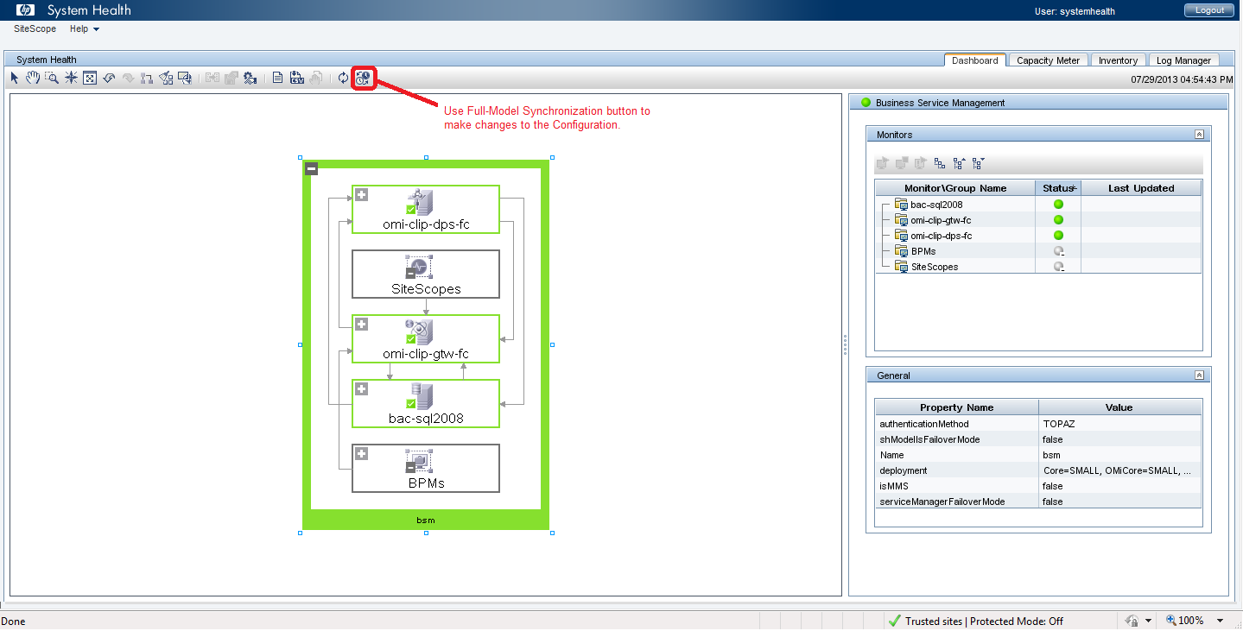
Installation – System Health Post Setup

Slide 28
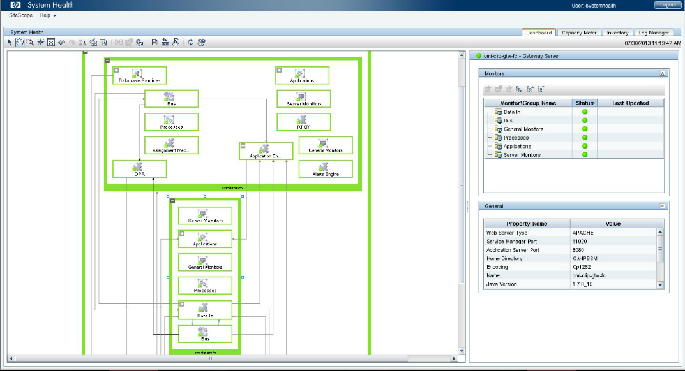
Installation – System Health Post Setup

Slide 29

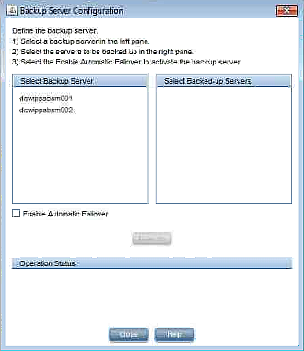
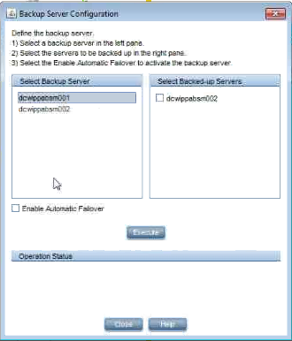
Monitoring Using System Health –
Backup DPS Server Configuration

Slide 30

Conclusion
If you are using BSM – consider using System Health.
System Health can help you:
Find potential problems before they become critical issues
Isolate source of problems
Manage your BSM installation
Create a healthy based-lined System in System Health
Any System Health Warning or Error can be addressed by opening an HP BSM Support Case
System Health is your key to a physical fit BSM installation!

