Slide 1
RUM
Protocols SDK
2010

Slide 2
RUM Overview

Slide 3
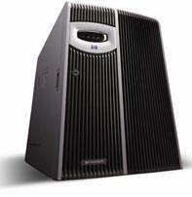


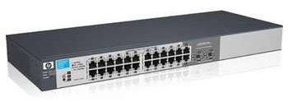
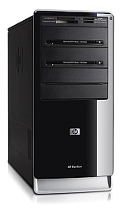
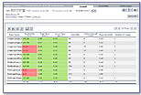
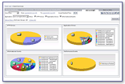
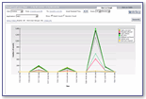
Overview
Gateway/switch
Internet
Application Servers
RUM
BSM

Slide 4
Data Flow – High-level View
Network
RUM
Probe
RUM
Engine
BSM
n

Slide 5
TCP-Level Reports

Slide 6
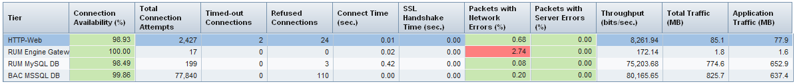
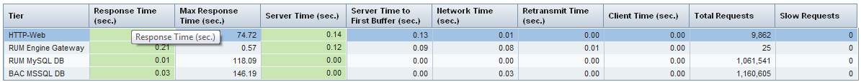
General TCP-level Reports
No protocol parser is required
Network Statistics
Average Request response time breakdown

Slide 7
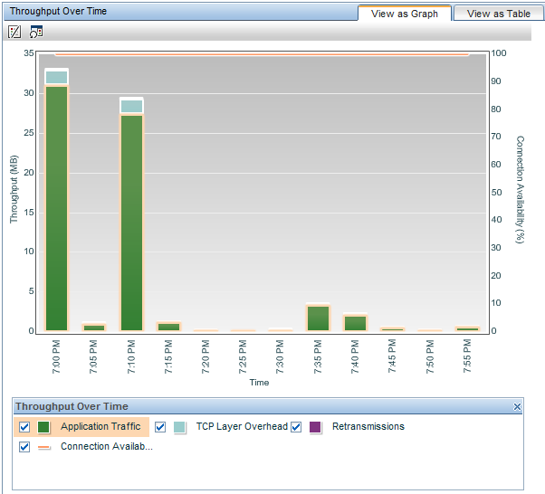
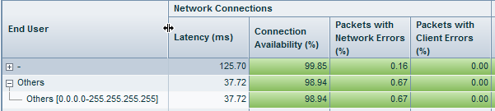
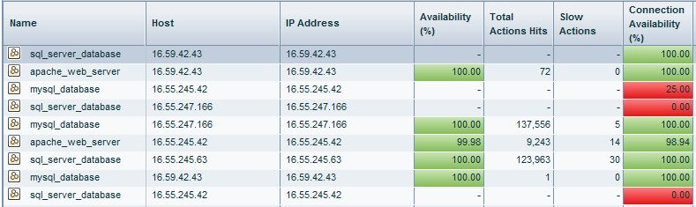
General TCP-level Reports
Additional presentations
  Over-time graphs
  Breakdown by End User
  Breakdown by Software Elements

Slide 8
Protocol Parser - ROLES

Slide 9
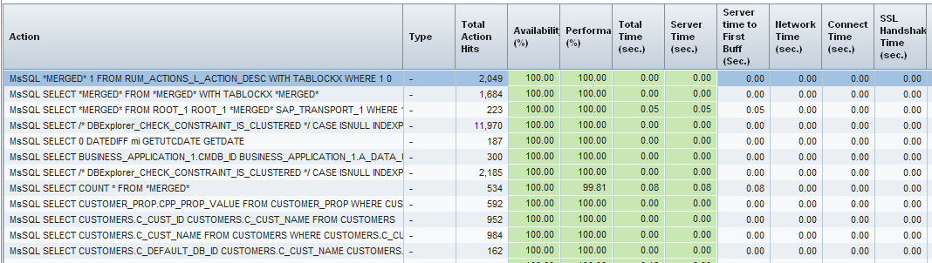
Protocol Parser: descriptor
Provides “descriptor” for each action.
  Clear names for the actions
  Aggregation by action types (classification algorithm)

Slide 10
Protocol Parser: actions
Aggregate individual requests to “actions”
  Better represents end-user experience
  Example – Web pages. A browser makes multiple HTTP requests:
    HTML page
    Style Sheet page (CSS)
    JavaScript code
    Logo image
    all those get aggregated to single “page” in reports.

Slide 11
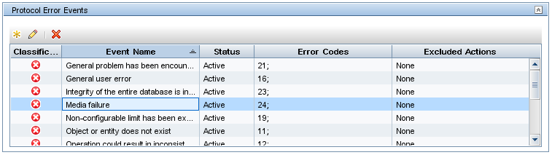
Protocol Parser: status code
Based on “status code” we know whether each action has succeeded, and can calculate the availability of the server.
  “Connection availability” is already a part of TCP-level information
Example: Microsoft SQL Server error codes.

Slide 12
SDK Overview

Slide 13
RUM Probe – Processing Stages
Most of the processing is already performed by the framework:
Capture Network Packets
Assemble TCP Connections
Generic Network Parameters
Break Connection to Requests
Publish Data to Engine
Post Processing
Protocol Parser
Response Time Breakdown

Slide 14
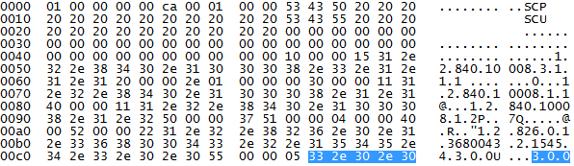
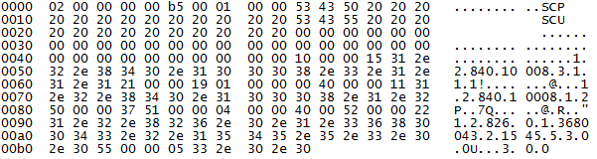
Protocol Parser Basics
Request Buffer
Response Buffer
DICOM Parser
Descriptor: ASSOCIATE request SCU --> SCP
Status-code: 0
Request-type: ASSOC
Presentation-context: Verification SOP
User-version: 3.0.0
…

Slide 15
Parser Types
Configuration File
  For textual protocols
  Based on Regular-Expression matching
  Fast to develop, easy to manage
Code
  C++ Dynamic Library
  Any content type
  More flexible parsing
  General utility classes are provided

Slide 16
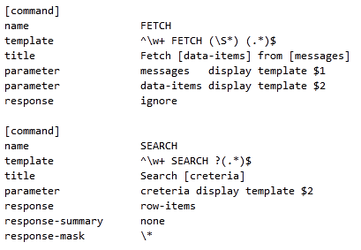
Textual Parser
Example of configuration file (IMAP Protocol):
Regular Expression to match this command
Descriptor String
Output parameters

Slide 17
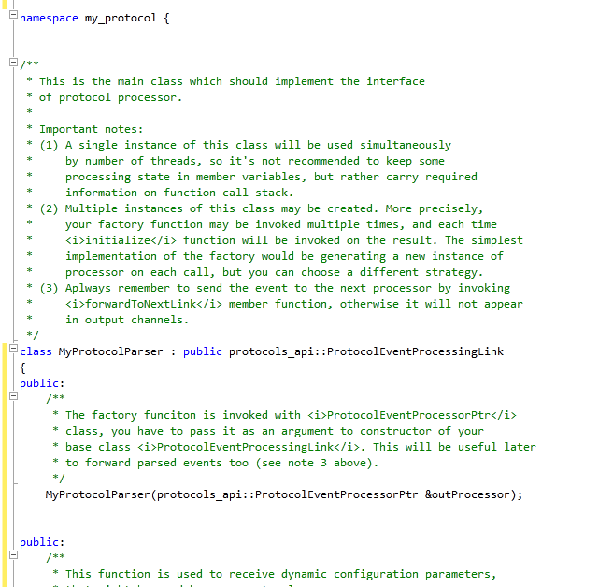
Parser in Code
Sample parser class: implements a special interface

Slide 18
Configuration Files
Total effort to create all files: about 1 day
BSM – Protocol Template file
  Protocol-specific attributes
  Default application values
  Controls the appearance of the data in reports
RUM Engine
  Mapping between BSM Template and Parser name
RUM Probe
  Parser configuration

Slide 19
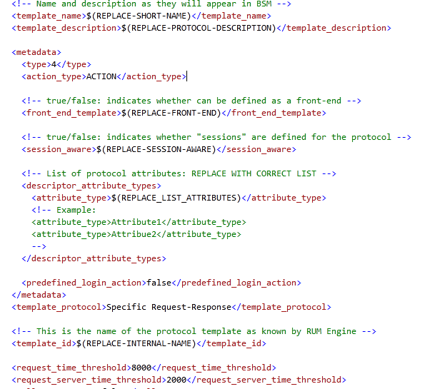
BSM – Protocol Template (XML)
Fill appropriate values in stub template file:
Protocol name
List of protocol-specific attributes
Error Response Codes
Default IP/port range

Slide 20
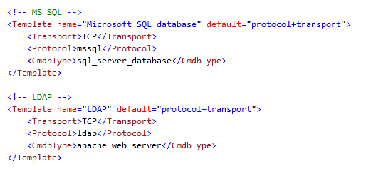
RUM Engine – Mapping File
Maps between the template file in BSM and the Protocol Parser in the Probe.

Slide 21
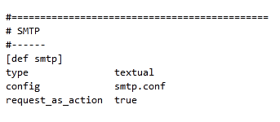
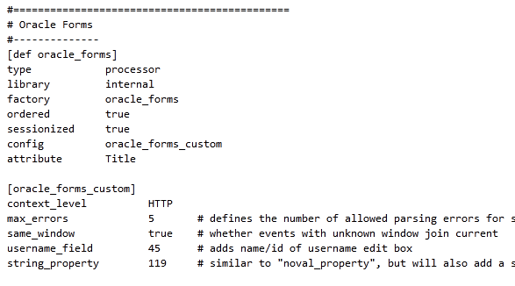
RUM Probe – Configuration File (INI)
Type of the parser
Name of the DLL/Textual configuration file
Protocol configuration

