Slide 1
RUM Security FAQ
“Can RUM meet PCI DSS requirements?”
  PCI: Do not use vendor-supplied defaults for system passwords and other security parameter
    Change the RUM and BAC default passwords to comply with this requirement.
  PCI: Protect stored cardholder data
    Strip the card holder data out entirely from the session so it is never stored in RUM.
    If the data is stored in RUM, secure access through unique User IDs and Passwords and harden the OS and Database using industry standards.
    Data transmissions of data is always encrypted via SSL using HTTPS or SSH
    RUM has made virtual access controllable by physical location via network filtering capabilities associated with replay and raw data access
  Other PCI requirements can be meet using IT process such as virus protection, intrusion detection, Information Security Policy and industry standard security practices

Slide 2
RUM Security FAQ
“Can RUM meet HIPAA requirements?”
RUM can be configured in a secure manner that meets HIPAA requirements:
Encryption for all data in transit via SSL using HTTPS or SSH
In memory http parameter data masking cleansing at the probe
User & Role based visibility controls limit who can see what data
Data granularity control by user to set who can see individuals or aggregate data
Ability to selectively disable data depth and collection by application and user
VPN compatible
Listen only interfaces

Slide 3
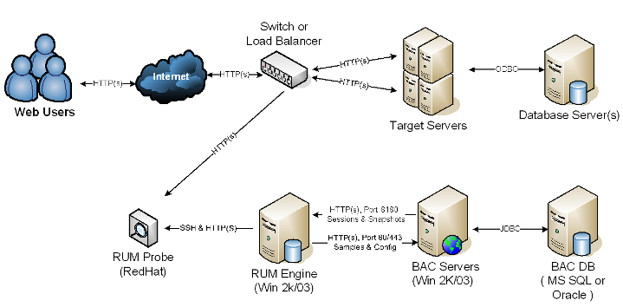
RUM Security FAQ
“Can RUM transmit customer data across the network using encryption?”
Secure
Encrypted
Connections

Slide 4
RUM Security FAQ
“Can we control who would have access to customer data in our environment based on a business need to know?”
BAC provides Individual User Management controls to assign permissions for RUM:
  Access control for RUM Engines
  Access controls for RUM Engine settings by Engine Instance
  Domains under RUM Engine Instances
  RUM Applications in BAC
  RUM Alerts
  RUM Reports

Slide 5
RUM Security FAQ
“Will RUM expose user IDs and Passwords along with other sensitive data?”
RUM can and should be configured to mask any sensitive data
How does it work……..

Slide 6
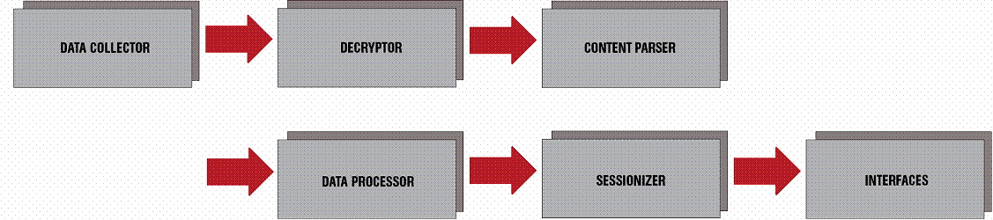
RUM Security FAQ
Masking Sensitive Data in RUM
The probe gets raw traffic from the tap or span port, decrypting the data first, if required, then parsing the content
The probe then masks or removes sensitive http parameter data you define via the interface or regular expressions
HTTP parameter data cleansing happens in memory so nothing sensitive is written to disk to compromise
Next components are assembled to form one logical page
Finally, the pages are arranged into one logical user session before being written to a secure file system on the RUM Engine for collection

Slide 7
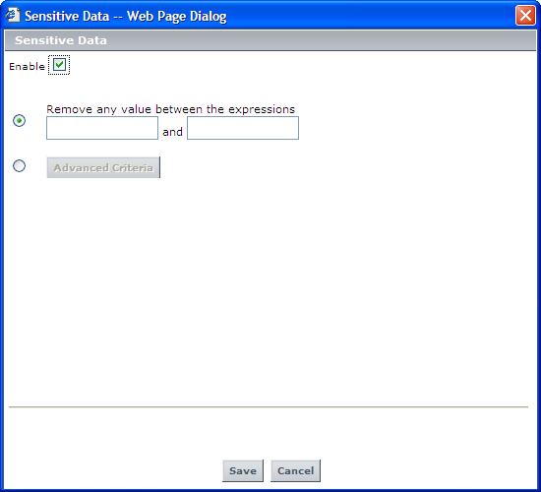
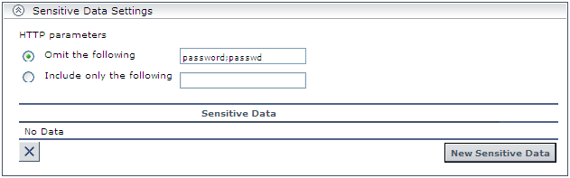
RUM Security FAQ
Defining Sensitive Data Settings
Enter HTTP parameters to either omit or include selected data
You can configure RUM to mask all URL parameters
Notes:
Note that cleansing of sensitive HTTP parameter data, such as passwords, is handled in memory by the probe.
For snapshot data, masking of sensitive data occurs when the data is requested for viewing, preventing sensitive data items from being viewed by the user.

Slide 8
RUM Security FAQ
Masking URL Parameters
  To enable masking of all URL parameters except for those configured as sensitive data in an application:
    In the < HP RUM root directory > \conf\configurationmanager\Beatbox_Default_Const_Configuration.xml file on the RUM engine, under the [global] section, add the following line:
    reverse_omit_parameters true
Notes:
By default, URL parameters configured as sensitive data for an application in
End User Management Administration are displayed as asterisks (*). You can
configure the HP Real User Monitor probe to mask all URL parameters. If
you configure the HP Real User Monitor probe to do this, all URL parameters
are displayed as asterisks, except for those that are configured as sensitive
data for an application in End User Management Administration, which are
then displayed in full

