Slide 1
ESM HA Cluster Installation and troubleshooting

Slide 2
Change History
March 2016: Initial Presentation created by Muharem Dervisevic and Gustavo Sáenz
March 2016: Advanced troubleshooting steps by Muharem Dervisevic
Accomodated to new HPE design

Slide 3
Agenda
ESM HA Component Overview and Terminology
  ESM HA Terminology
  Software Requirements
  Hardware Requirements
ESM HA Installation and Troubleshooting
  Installation Scenarios
  Installation process
  Troubleshooting Installation failure
  Cluster Troubleshooting and Documentation

Slide 4
ESM HA Terminology

Slide 5
Intranet
PRIMARY
SECONDARY
eth-0
eth-0
PACEMAKER
16.103.74.24
16.103.74.224
PACEMAKER
Service IP
(cluster 16.103.74.23)
ESM
File System
Distributed Replicated Block Device
Interlink cable
Distributed Replicated Block Device
eth-1
eth-1
192.168.145.24
192.168.145.224
Disk 1
Disk 2
iPDU

Slide 6
ESM HA Terminology
HA: High Availability or Failover Cluster Solution for ESM
Nodes: Servers part of the Clustering Solution (Maximum 2)
Passive/Failover: Only Cluster configuration currently supported
HDD: Each server/node must have it’s own hard drive.
Service IP: Shared IP address used by the Cluster solution. Never directly configured on any server.
Node IP: IP address directly configured on each Node of the cluster.
Service Hostname: Shared hostname for the cluster. Used for console login and Command Center Access
  Primary Hostname: Hostname assigned to the primary server/node of the cluster
  Secondary Hostname: Hostname assigned to the secondary server/node of the cluster
Primary Cable IP: IP address configured on the interconnect network interface of the primary server/node
Secondary Cable IP: IP address configured on the interconnect network interface of the secondary server/node

Slide 7
ESM HA Terminology Contd.
Shared Disk: Mount point or partition where ESM directories will be located on both servers. Each server must have it’s own disk
Metadata Volume: Small raw partition used for the clustering technology to determine the synchronization status of the drives.
Connected Hosts: IP addresses used by the Clustering Software to confirm if a particular node has internet connectivity or not.
Preferred Primary: Server/Node that where ESM services will be running regularly
Heartbeat/Pacemaker: Mechanism used to ensure the nodes on the Cluster are online
DRBD: Synchronization Software implemented for HA

Slide 8
Software Requirements

Slide 9
ESM Version Dependent
ESM 6.8 and latest Patches
ESM 6.9.1
RHEL 6.5, 6.6
ArcSight HA 1.0
License with HA module Enabled
Yum Repository
RHEL 6.7, 7.1
ArcSight HA 1.1
License with HA module enabled
Yum Repository

Slide 10
Hardware Requirements

Slide 11
Hardware Requirements
The 2 nodes of the cluster must contain the same hardware specs otherwise they need to have similar values for the following resources
CPU
RAM
HDD
Ethernet Ports
Notes:
If the differences in hardware are too big between the nodes (specifically RAM and CPU) the server with the lowest amount will be impacted if ESM needs to be launched on such node.

Slide 12
HDD Partitioning
HDD configuration on both servers has to be identical
Do not use default /home partition configuration defined by RHEL or CentOS
/root, swap and system partitions may use default settings
Shared disk:
        Must have it’s own partition
        Will be mounted under /opt directory
        Recommended to use LVM partition to allow resizing
        ESM Files will be located here
        Contents of this disk are synchronized by DRBD software
        Xfs or ext4 file systems supported

Slide 13
HDD Partitioning Contd.
Metadata volume
        Partition used by DRBD to ensure hard drives are properly synchronized
        Raw partition so it will never have a proper file system
        Very small size, not bigger than 512MB
        Recommended to use LVM for such partition
        Will never have a mount point
        Will never have a file system configured
Notes:
The size in megabytes
(MiB, 1,048,576 bytes) can be calculated as size=(P/32768)+1, where P is the size of the mirrored
partition in mebibytes. For example, if the mirrored partition size is 1 TiB (P=1,048,576 MiB), the
metadata partition size would be 33 MiB.
Assuming that the disk will be 2.2TiB (it
will of course be a little smaller than that), the metadata partition must be at least (2.2TiB/32778) + 1 = 72 MiB.

Slide 14
Ethernet Ports
Minimum 2 Ethernet ports
        Eth0: node IP
        Eth1: interconnect IP
        Interconnect IP used by DRBD to synchronize the disks between the nodes
        Interconnected via crossover cable. Avoid using extra hardware to ensure connectivity
        Very close proximity between the nodes as Interconnect cable must be crossover
        5 IP addresses
Notes:
You can used bonding technology for the interconnect IP in order to have redundancy.

Slide 15
ESM HA Installation and Troubleshooting

Slide 16
Installation Scenarios

Slide 17
Installation Flow Chart

Slide 18
ESM is not installed
Fastest Deployment
Synchronization not required
HA installation will take place first
ESM will be installed after HA is fully functional
ESM content is sync between nodes as it is installed

Slide 19
ESM is Installed
Slow Deployment
Second node will need to be sync
HA will be installed on node where ESM is running
HA will automatically be installed on both nodes
Synchronization process will start once HA is fully functional
Synchronization is automatic
10 TB might take up to 2 days to synchronize
ESM will be in HA until synchronization process is complete
May require manual synchronization in case of failure
Connectors will need to be registered again to the service/floating hostname

Slide 20
ESM HA Upgrade
Complex upgrade
OS Upgrade is required as well
HA module needs to be upgraded first
HA upgrade needs to be duplicated across both nodes
ESM upgrade will take place until HA is fully functional
Synchronization process may not be required as drives are already sync
Additional Headache if upgrade process fails

Slide 21
Installation Process

Slide 22



Nodes Configuration
Node 1 Setup
OS Installation
ESM HA Installation
ESM Installation
Node 2 Setup
Notes:
One single image can be used to ensure both systems are setup the same way.

Slide 23
HDD Partitioning
Device | Mount Point | Filesystem Type
/dev/mapper/vg_esmnode1-lv_root | / | ext4
/dev/sda1 | /boot | ext4
/dev/mapper/vg_esmnode1-lv_home | /home | ext4
/dev/mapper/vg_esmnode1-lv_opt | /opt/arcsight | ext4
/dev/mapper/vg_esmnode1-lv_swap | None | swap
/dev/mapper/vg_esmnode1-lv_metadata | None | Raw
/opt and metadata Device name must be exactly the same on both servers
Notes:
Make sure NOT to use the default partitioning defined by the OS installer
Ensure the biggest partition is /opt/arcsight as here is where ESM filles will be located
Make sure the metadata partition is created at this point so the continuous space is properly setup for such partition
Create a new VG and LV for the shared disk and metadata partition

Slide 24
Networking Configuration
Server | Device | IP | Hostname
Server1 | eth0 | 15.194.211.x | Esmnode1.test.lab
Server1 | eth1 | 192.168.200.10 | N/A
Server2 | eth0 | 15.194.211.y | Esmnode2.test.lab
Server2 | eth1 | 192.168.200.11 | N/A
Service IP: 15.194.211.z
Service Hostname: esmcluster.test.lab
/etc/hosts file must contain all the hostnames with their respective IPs
IPs without hostname are interconnect IP’s and must be connected via crossover cable

Slide 25
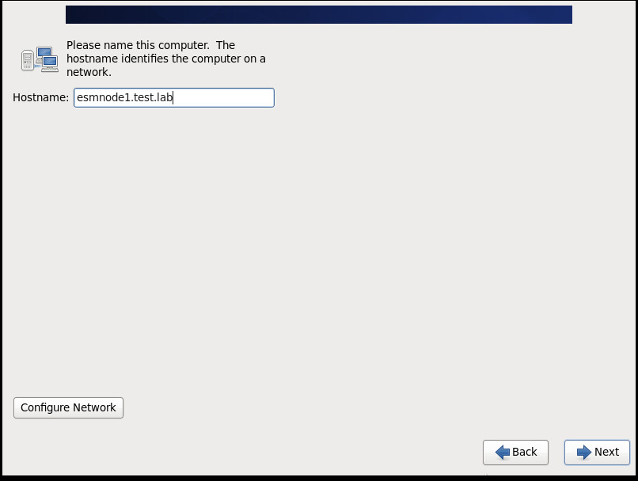
OS Installation Screenshots

Slide 26
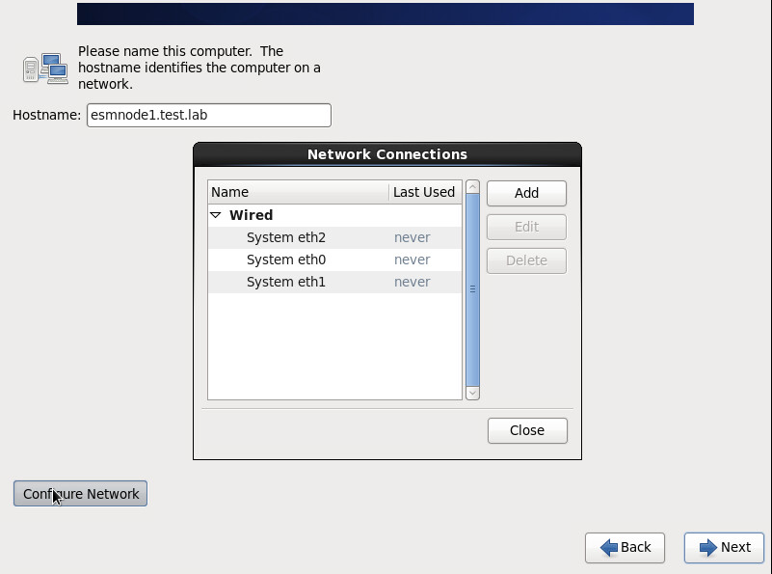
Network Configuration

Slide 27
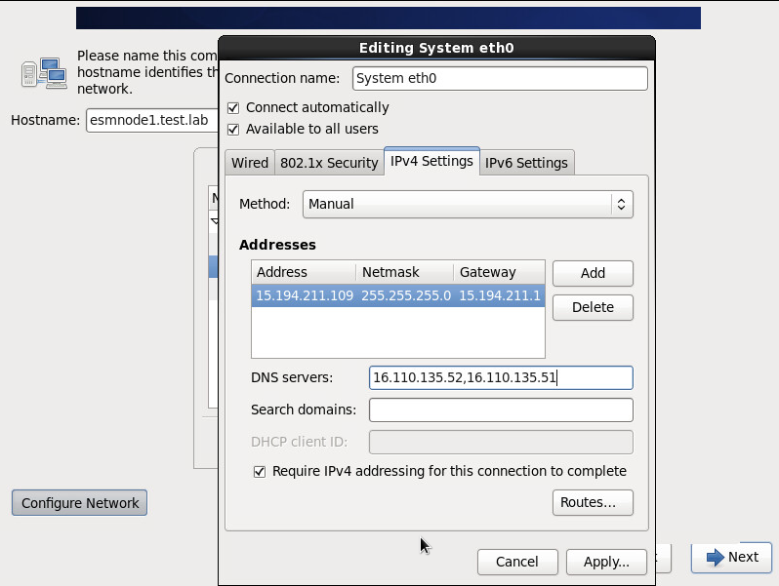
Nodes IP addresses
This is the Official Node IP address which is visible to the world

Slide 28
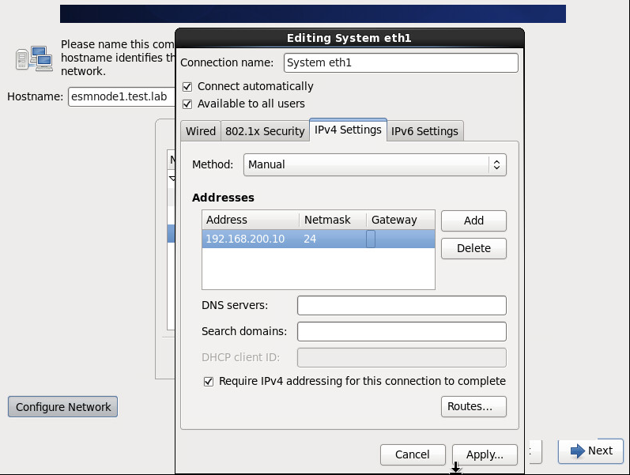
IP Service Configuration

Slide 29
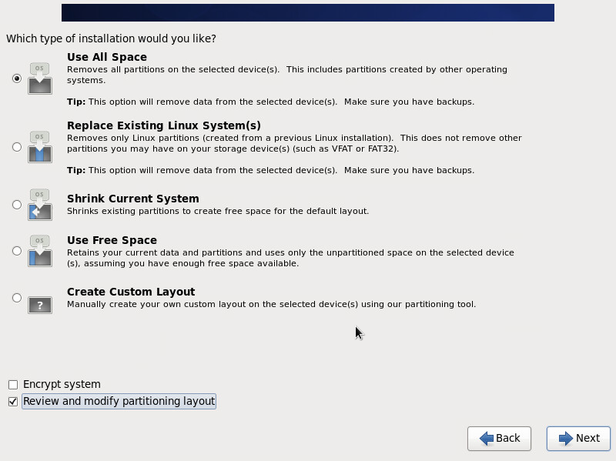
HDD Initial Configuration
Make sure to select the “Review and modify partitioning layout” option to repartition the system properly

Slide 30
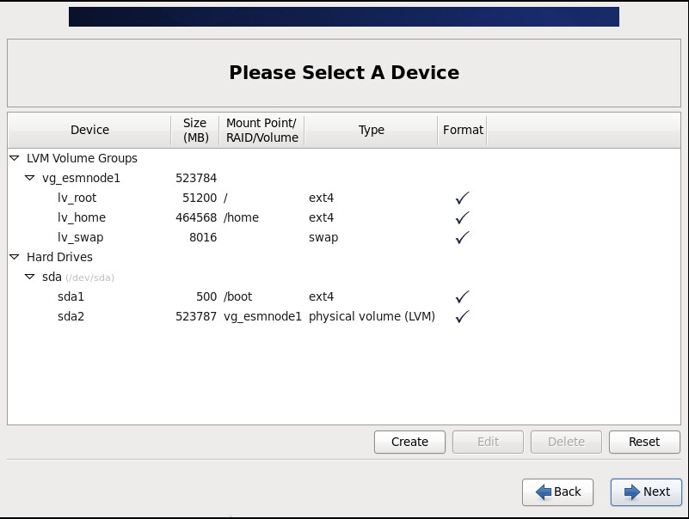
Default HDD Partitioning (DO NOT USE THIS ONE)

Slide 31
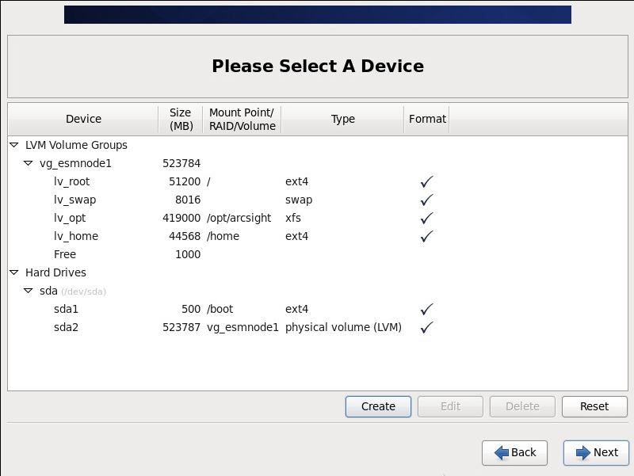
Partitioning Required for Cluster

Slide 32
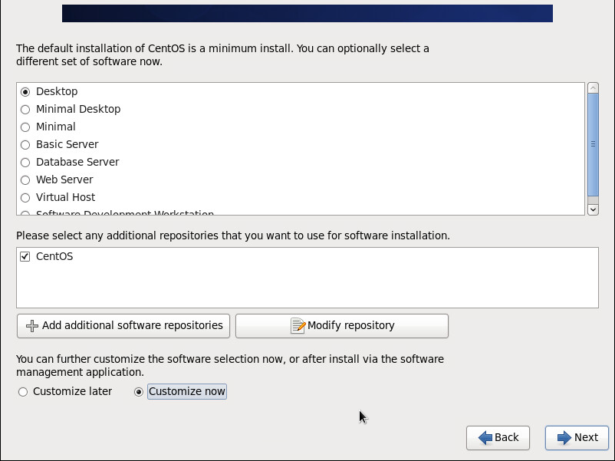
Install Compatibility libraries
Select the radio option “Customize now” and click on “Next” button

Slide 33
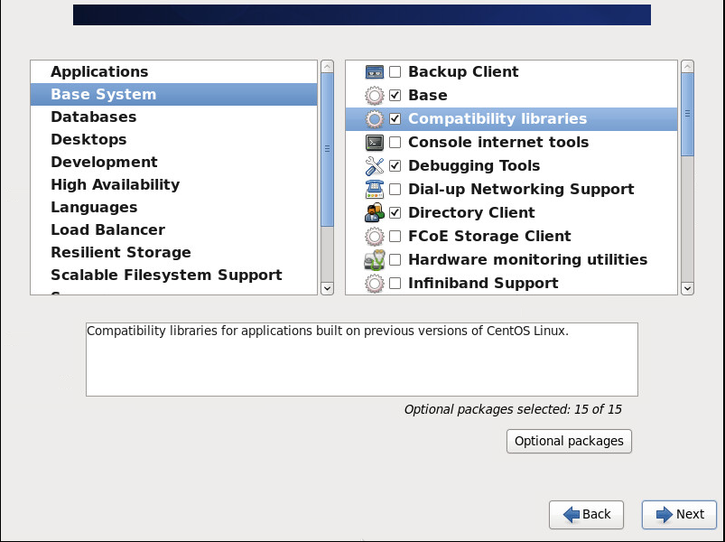
Select Compatibility libraries

Slide 34
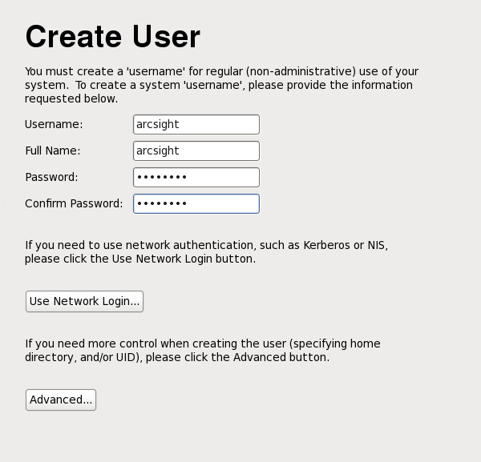
User arcsight creation

Slide 35
Commands to create metadata partition
vgdisplay: focus on the VG Name and the value for “Free PE / Size” to make sure there is space available
lvcreate –l 100%FREE –n lv_metadata vg_esmnode1
lvdisplay will show the information about the new partition details

Slide 36
eth0 Configuration (Service IP)
DEVICE=eth0
TYPE=Ethernet
UUID=85f04188-801f-4471-999a-0facbf25feae
ONBOOT=yes
NM_CONTROLLED=yes
BOOTPROTO=none
HWADDR=00:0C:29:6A:27:35
IPADDR=15.194.211.109
PREFIX=24
GATEWAY=15.194.211.1
DNS1=16.110.135.52
DNS2=16.110.135.51
DEFROUTE=yes
IPV4_FAILURE_FATAL=yes
IPV6INIT=no
NAME="System eth0"

Slide 37
Eth1 Configuration (Cluster IP)
DEVICE=eth1
TYPE=Ethernet
UUID=6e0d7c3d-e6c6-4f78-8fc0-f5ca69f58c27
ONBOOT=yes
NM_CONTROLLED=yes
BOOTPROTO=none
HWADDR=00:0C:29:D1:37:05
IPADDR=192.168.200.10
PREFIX=24
DEFROUTE=yes
IPV4_FAILURE_FATAL=yes
IPV6INIT=no
NAME="System eth1"

Slide 38
Values required on /etc/hosts file
127.0.0.1 localhost localhost.localdomain localhost4 localhost4.localdomain4
::1 localhost localhost.localdomain localhost6 localhost6.localdomain6
15.194.211.101 esmcluster esmcluster.test.lab
15.194.211.109 esmnode1 esmnode1.test.lab
15.194.211.110 esmnode2 esmnode2.test.lab
~

Slide 39
Values for file /etc/security/limits.d/90-nproc.conf
# Default limit for number of user's processes to prevent
# accidental fork bombs.
# See rhbz #432903 for reasoning.
* soft nproc 10240
* hard nproc 10240
* soft nofile 65536
* hard nofile 65536

Slide 40
Additional Commands
service iptables stop # stop iptables firewall service
chkconfig iptables off # disable firewall so it won’t start at next reboot
chmod 777 /sbin
mkdir /usr/lib/arcsight #only on the primary node of the cluster
chown arcsight:arcsight /usr/lib/arcsight #only on the primary node of the cluster
Copy ESM installation files to the server and ensure ownership for arcsight user
Configure ntp as time needs to be properly sync across the nodes
rpm –Uvh tzdata-2014f-1.el6.noarch.rpm #install time rpm
rm –f /etc/localtime
ln -s /usr/share/zoneinfo/Europe/Prague /etc/localtime
Run the command yum search drbd to validate yum has internet access
Reboot the node
Notes:
DRBD is using timestamps to ensure synchronization of the shared disk. Ensure NTP is configured so both servers have the same time.

Slide 41
Settings both nodes must have
Both nodes must have the same Supported OS
Arcsight user id and group id must be the same on both nodes
Metadata partition must have the same name, size and mountpoint on both nodes
Shared disk must be the same size, filesystem type and mountpoint on both nodes
Both nodes must have the same time zone data package installed
Both servers must have NTP properly configured
Root password must be the same for both nodes ONLY during installation process
Ensure yum application is able to access the internet to install the packages
Notes:
HA installation is the one in charged of exchanging ssh keys between the cluster nodes so password won’t be needed after a successful installation
You can install the rpms manually in case the cluster nodes don’t have internet access.

Slide 42
Additional helpful commands
id: run it while logged in as arcsight user to get it’s id and group id
ulimit –a: ensure proper OS limits were defined
To setup a proxy for yum just add the line proxy=<PROXY:PORT> to /etc/yum.conf
Replace <PROXY:PORT> with the proper IP or URL and Port
Notes:
Id command to ensure both nodes have the same id for arcsight user and group
Ulimit –a to make sure we setup the limits properly for a successful esm installation
There is a workaround to manually install the rpms in case the nodes don’t have direct internet access to install the rpms via yum

Slide 43
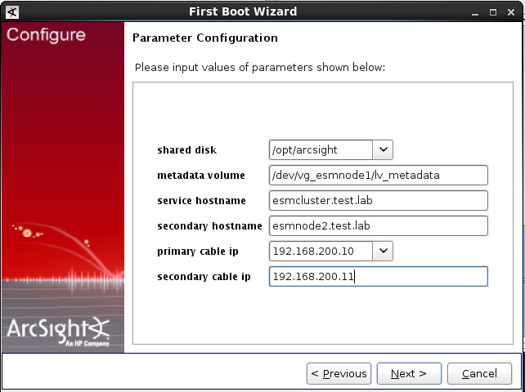
ArcSight High Availability installation
Values required for HA successful installation

Slide 44

ArcSight High Availability Installation Contd.
The best IP address to write under connected hosts is the gateway
Notes:
Connected hosts are the IP’s DRBD will use to determine if a node is available or not

Slide 45
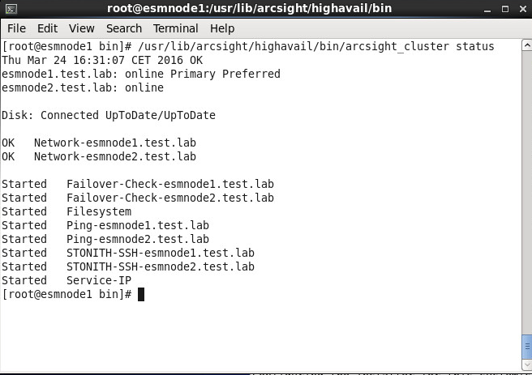
Confirm HA is successfully installed

Slide 46
How to perform ESM installation
ESM will be installed on the primary node only.
Content is automatically sync between the nodes automatically
Installation must be launched as arcsight user
Ensure /opt/arcsight directory has ownership arcsight:arcsight
Once installation is completed make sure to run the command /opt/arcsight/manager/bin/setup_services.sh as root to install the services

Slide 47
ESM is already installed

Slide 48
ESM already installed Flow
Download installers to esmnode1
Install ESM HA on node 1
Synchronize nodes (Automatic)
Load HA Package (Console)
Uninstall ESM Services
Reinstall ESM Services
Start all services
Upgrade ESM to latest Patch
Install OS and configure node 2
Reinstall ESM Services
Recreate ESM Certificates

Slide 49
ESM already installed
Upload ESM installers to node 1
Install the HA Package through the Console
Upgrade ESM to the latest Patch
Install and preconfigure second node. DO NOT INSTALL ESM!
Uninstall services: /opt/arcsight/manger/bin/remove_services.sh (root)
Install ESM HA Module as arcsight user on node 1
Check sync status: /usr/lib/arcsight/highavail/bin/arcsight_cluster status

Slide 50
ESM already installed Contd.
Reinstall services: /opt/arcsight/manager/bin/setup_services.sh (root)
Stop manager service: /etc/init.d/arcsight_services stop manager
Stop arcsight web service: /etc/init.d/arcsight_services stop arcsight_web
Create a new manager certificate based on Service Hostname (managersetup)
Start manager service: /etc/init.d/arcsight_services start manager
Create new webserver certificate based on Service Hostname (webserversetup)
Start arcsight web service: /etc/init.d/arcsight_services start arcsight_web
Notes:
As a workaround you can define the primary server IP address and hostname as the service IP and assign a new IP and hostname to the primary node. This way you don’t have to recreate the certificate for the manager and the web server.

Slide 51
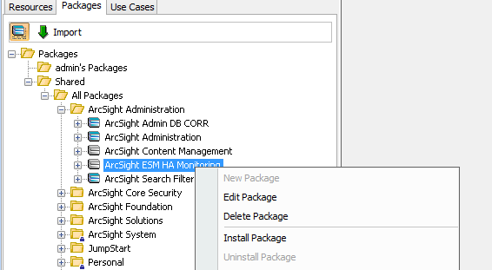
HA Package Installation

Slide 52
First Node Requirements
Change permissions to /sbin directory to 777
Create metadata partition
Create directory /usr/lib/arcsight with ownership arcsight:arcsight
Run script /opt/arcsight/manager/bin/remove_services.sh
Include service and node 2 hostname on /etc/hosts file
Make sure yum is properly configured to install HA rpm packages

Slide 53
Second Node Requirements
Same OS version as Primary node
Time zone package must be installed
NTP protocol must be enabled on both nodes
Crossover cable between Interconnect Interfaces
Password for root user must be the same during installation
Arcsight user and group must have the same id
Change permissions to /sbin directory to 777
Create metadata filesystem
Set proper parameters to file /etc/security/limits.d/90-nproc.conf
/etc/localtime pointing to the same timezone as node 1
Include cluster and node1 hostname entries on /etc/hosts
Make sure yum repository is properly configured to install HA rpm packages
Reboot the server

Slide 54
Upgrade ESM in HA Mode

Slide 55
Upgrade 6.9.1 Flow
Download installers to esmnode1
Uninstall ESM Services
Upgrade OS on esmnode1
Disable Cluster services
Upgrade OS on esmnode2
Upgrade HA Module on esmnode1
Upgrade ESM on esmnode1

Slide 56
6.9.1 ESM HA Upgrade steps
Download installers to esmnode1
Ensure HA package is installed via the Console
Stop heartbeat HA service on esmnode2: /sbin/service heartbeat stop
Remove heartbeat service on esmnode2: /sbin/chkconfig –del heartbeat
Upgrade esmnode2 to CentOS version 6.7: /usr/bin/yum update
Reboot esmnode2
Uninstall ESM services: Tools/stop_services.sh from 6.9.1 installer folder
Stop heartbeat HA service on esmnode1: /sbin/service heartbeat stop
Remove heartbeat service on esmnode1: /sbin/chkconfig –del heartbeat
Upgrade esmnode1 to CentOS version 6.7: /usr/bin/yum update

Slide 57
6.9.1 ESM HA Upgrade steps Contd.
Reboot esmnode1
Ensure root password is the same on both nodes
All hostnames are added on /etc/hosts
Time zone package is properly installed on both nodes
Proper symlink to /etc/localtime is configured
Arcsight userid and group id are the same on both nodes
Run the HA installer to copy upgrade files to esmnode1 (arcsight)
Upgrade HA: /usr/lib/arcsight/highavail/install/upgrade.sh (root)
Upgrade ESM on esmnode1 (arcsight)
Install services on esmnode1: /opt/arcsight/manager/bin/setup_services.sh (root)

Slide 58
Troubleshooting

Slide 59
Troubleshooting Commands
df –h /dev/drbd1: shared disk mounted
/usr/lib/arcsight/highavail/bin/arcsight_cluster status
/usr/lib/arcsight/highavail/bin/arcsight_cluster diagnose
drbdadm invalidate opt: forces drbd to do a full resync on the disks. Do it on the offline mode.
crm configure show: show detailed clustering configuration
Notes:
Be extremely careful with drbdadm invalidate opt command as you have to make sure to do it on the node where synchronization was lost. Otherwise you could lose data as you will be synching the wrong drive.

Slide 60
arcsight_cluster status command
Fri Mar 25 21:22:46 CET 2016 FAIL Disk: UpToDate/Outdated, 1 Nodes offline, 3 Resources Stopped
esmnode1.test.lab: online Primary Preferred
esmnode2.test.lab: offline
Disk: WFConnection UpToDate/Outdated
OK Network-esmnode1.test.lab
OK Network-esmnode2.test.lab
Started ESM
Started Failover-Check-esmnode1.test.lab
Stopped Failover-Check-esmnode2.test.lab
Started Filesystem
Started Ping-esmnode1.test.lab
Stopped Ping-esmnode2.test.lab
Started STONITH-SSH-esmnode1.test.lab
Stopped STONITH-SSH-esmnode2.test.lab
Started Service-IP
Overall HA status
Disks Status
Specific node status
Disk Connectivity Status
Nodes external Connectivity
ESM Status
Can failover be done?
Is filesystem mounted?
Are nodes reachable internally?
Allows nodes to reboot each other
Is cluster IP available?

Slide 61
Disk Communication Status
Connection State | Description
Connected | Data is being mirrored normally.
StandAlone | There is no network connection.
SyncSource | Disk synchronization is underway from the local machine to the other machine. That is, this machine is the primary
SyncTarget | Disk synchronization is underway from the other machine to this machine. That is, this machine is the secondary.
WFConnection | This machine is waiting for the other machine to connect to it.
Unconfigured | The server where this command was executed is offline.
Notes:
Copy exactly as it is detailed on the User Guide. This status explains if the disks can communicate with each other to sync data

Slide 62
Disk Data Status
Connection State | Description
Connected | Data is being mirrored normally.
StandAlone | There is no network connection.
SyncSource | Disk synchronization is underway from the local machine to the other machine. That is, this machine is the primary
SyncTarget | Disk synchronization is underway from the other machine to this machine. That is, this machine is the secondary.
WFConnection | This machine is waiting for the other machine to connect to it.
Unconfigured | The server where this command was executed is offline.
Notes:
Copy and pasted exactly as it is on the HA User Guide. These status help understand if the data between the disks is in sync or not

Slide 63
arcsight_cluster diagnose command
Provides basic status analysis about the current cluster situation
Provides general tips on how to resolve issues
High level command
Limited functionality

Slide 64
Which logs to analyze
Log directory Path: /usr/lib/arcsight/highavail/logs
Install.log: tracks installation of rpm packages and overall HA installation process on both cluster nodes
Install-console.log: tracks communication status between both cluster nodes.
firstBootWizard.log: tracks configuration of HA module on both cluster nodes
arcsight_cluster.log: monitors status of the cluster and of the particular node.
/usr/lib/arcsight/highavail/highavail.properties: configuration file
/var/log/messages: contains information regarding DRBD functionality
/usr/sbin/crm_report: generates real time report on both nodes of the cluster. Example: crm_report –f “2016-02-25 09:00:00” report.txt

Slide 65
ArrayIndexOutOfBoundException during installation
Fixed on 6.9.1
FirstBootWizard is not able to handle mountpoints that have additional mountpoints inside them
Mostly happens when customer has multiple mount points setup on their server
Workaround is to unmount all partitions before FirstBootWizard begins and then you can mount everything again.
Unmount specifically mount points not required for ESM HA functionality
/apps
/apps/arcsight: this will make FirstBootWizard throw the error

Slide 66
DRBD mirroring doesn’t start
Check interconnect interfaces status
Ifdown: bring an interface down
Ifup: bring an interface up for troubleshooting connectivity
DRBD will always do disks synchronization using interconnect interfaces
Bringing interfaces down won’t restart synchronization after bringing them up again
arcsight_cluster diagnose is your most useful tool on these scenarios

Slide 67
Failover problems
DRBD starts before the pacemaker: (most commonly on CentOS)
Run the command chkconfig –list drbd
Ensure every start level is in off.
DRBD can’t start before pacemaker otherwise it will not be able to sync the drives properly.
If failover can’t repair automatically, DRBD will “fence” the problematic resource to avoid further damage. Here are the steps to overcome this
crm configure show | grep “drbd-fence-by-handler”: if this shows something your device is fenced so you need to fix this
Crm configure
crm(live)configure# delete drbd-fence-by-handler-opt-rule-DRBD-Group
crm(live)configure# commit
crm(live)configure# exit

Slide 68
Routing metrics
/usr/lib/arcsight/highavail/bin/arcsight_cluster status
Wed Dec 9 11:36:21 PST 2015 FAIL Disk: UpToDate/UpToDate, 0 Nodes offline, 2 Resources Stopped
n15-214-129-h90.arst.usa.hp.com: online Preferred
n15-214-130-h198.arst.usa.hp.com: online Primary
…
Started F Service-IP
You can’t have one server being preferred and the other one being Primary
Why can’t disks sync? Check /var/log/messages
Both are primary!
Disks can’t sync

Slide 69
Routing metrics
/var/log/messages:
'....: info: RA output: (Service-IP:start:stderr) ERROR: Cannot use default route w/o netmask...'
'...: ERROR: [/usr/lib64/heartbeat/findif -C] failed...‘
ip route: Command showing the server routes and priorities
default via xxx.xxx.xxx.xxx dev ens32 proto static metric 100
12.34.128.0/19 dev ens32 proto kernel scope link src 12.34.156.78 metric1000
Fix:
ip route replace 12.34.128.0/19 dev ens32 metric 100
ip route delete 12.34.128.0/19 dev ens32 metric 1000
Cluster shouldn’t use default route
Service IP should be lowest

Slide 70
RPMs versions
CentOS is downloading newer RPMs from it’s repositories
Our HA distribution works with a specific set of rpms
When rpms are updated via yum CentOS repository is downloading newer ones causing our HA solution to fail.

Slide 71
RPMs on HA 6.9.1
drbd-8.9.2-1.el6.x86_64.rpm
drbd-bash-completion-8.9.2-1.el6.x86_64.rpm
drbd-heartbeat-8.9.2-1.el6.x86_64.rpm
drbd-pacemaker-8.9.2-1.el6.x86_64.rpm
drbd-udev-8.9.2-1.el6.x86_64.rpm
drbd-utils-8.9.2-1.el6.x86_64.rpm
drbd-xen-8.9.2-1.el6.x86_64.rpm
kmod-drbd-8.4.6_2.6.32_504-5.el6.x86_64.rpm
resource-agents-3.9.2-1.2011.29.9e9cf0e.221_cs_post_release.el6.x86_64.rpm

Slide 72
Other situations detected
arcsight_cluster online fails: hostnames are only supported in lower case
arcsight_cluster offline fails: hostnames are only supported in lower case
Make sure hostname is set in lower case.
Double check /etc/hosts file as well on both nodes
Primary node mysteriously reboots: STONITH service responsible of rebooting
Heartbeat hangs when is being stopped.
STONITH service thinks it needs to push the reboot
Forwarding Connector as Source for HA is not supported: Workaround available under bug NGS-16208
Most of these situations were detected on CentOS installations

Slide 73
Additional Settings

Slide 74
Increase size of shared disk
vgdisplay command: “Free PE / Size” to confirm if there is space available
In case there is no space available a new drive will need to be added to the VG
ls /sys/class/scsi_host: detect number of hosts to scan
echo "- - -" > /sys/class/scsi_host/host#/scan #host0, host1, host2
fdisk –l: ensure the new disk is detected by the OS. Review /var/log/messages
vgextend vg_esmnode1 /dev/sdb: new disk detected as sdb
lvextend –l +100%FREE /dev/mapper/vg_esmnode1-lv_opt: use the entire disk
Perform these steps on esmnode2
/usr/lib/arcsight/highavail/bin/arcsight_cluser increaseDisk: only on primary node
xfs_growfs /dev/drbd1: sync disk will be able to use the new space
Increase Storage Groups so ESM can use the additional space

Slide 75
Additional references
HA User Guide
DRBD Userguide: http://drbd.linbit.com/en/use-cases/high-availability
FT_ESM_HA_TOK-Feb2016.ppt: FT Presentation from Jennifer Treichler
Recording: Transfer of Knowledge from Jennifer Treichler

Slide 76
Make it matter

