Slide 1
HP Business Service Management

Slide 2
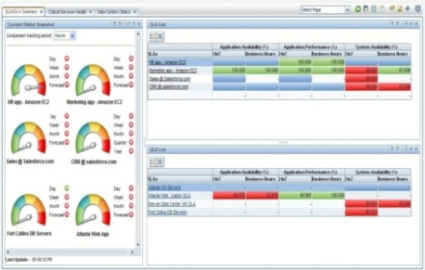
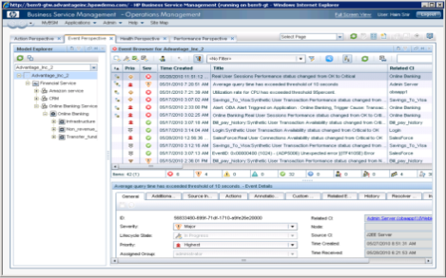
HP Business Service Management
Achieve operational excellence…in a dynamic world
Application Performance Management
End-user experience
Transactions
Application diagnostics
Universal event correlation &
Service Intelligence
Run-time Service Model
Comprehensive, automated and up-to-date
model for dynamic services
Server
Network
Virtualization
3rd party monitoring tools
Infrastructure Performance Management
Notes:
Achieve operational excellence by managing dynamic business services
Achieve operational excellence by obtaining complete visibility into dynamic environments
Achieve operational excellence to manage dynamic IT while aligning with the business
BSM 9.1 is the second product release on the BSM 9 platform. In many cases, customers are wary of a dot zero version, so this is our signal to the market that our BSM 9 platform is production worthy.
Our core value proposition is that BSM ties together top-down and bottom-up monitoring. This has been the message since HP acquired Mercury back in 2006.
BSM 9 brought these two approaches together in a common platform. BSM 9.1, with its easy upgrade paths, means that customers can benefit from the tight integration and easily add application monitoring to their operations stack OR add a full-featured event console (OMi) to their application monitoring solution.

Slide 3
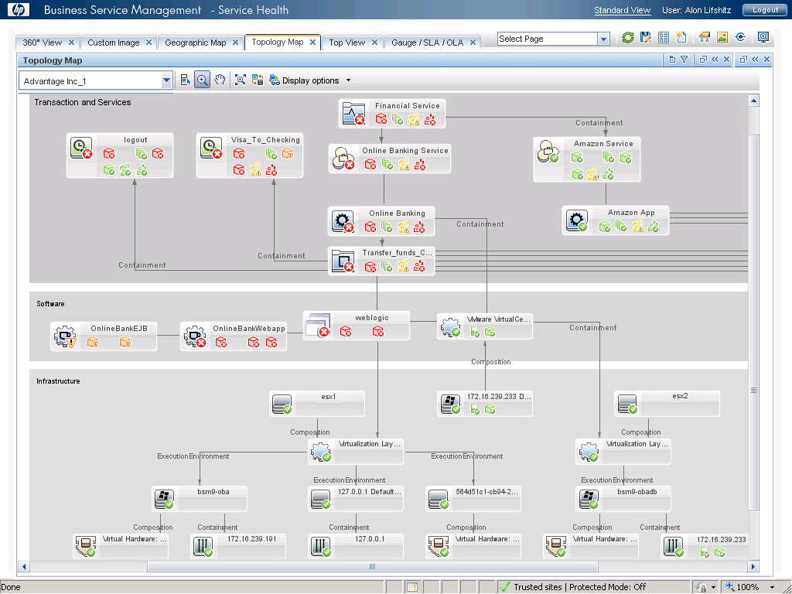
Run-time Service Model
Comprehensive, automated, and up-to-date model for dynamic services
Application Performance Management
Run-time
Service Model
Infrastructure Performance Management
Integrated/Federated
HP CMS
3rd party CMDB
Notes:
Note to presenter, Explain the map from top to bottom….ability to create relationships out of the box….all datacollectors feed into the RTSM that build the relationships. Its realtime – big value, vmotion app from server A to server B, you will have to depend on your CMS to update during the next update cycle with RTSM it does it automatically
Additional notes: So how do we integrate the bottom-up infrastructure and top-down application views. We do it using the Run-Time Service Model. The RTSM provides a run-time operational view of the service, which is key to managing the operations within a cloud environment, whether public, private, or a hybrid IT environment. Since cloud environments are inherently dynamic many time there is no way to manually keep track of service maps that show the complex interdependencies of delivering a business service. This is where the Run-time Service Model comes into play.
Using the existing monitoring instrumentation for networks, servers, and applications, HP BSM automatically builds the Run-time Service Model. Then, as the environment changes, the RTSM automatically tracks the changes and updates the model. This is useful for performing impact analysis. If part of the on-premise or cloud infrastructure fails, you can see which business services will be affected.
The Run-time service model provides:
* Is comprehensive – it maps all the service elements – business processes, transactions, applications, infrastructure elements – physical or virtual and across the internal data center or the cloud environment. This is as comprehensive a view of the service as you can ever get. We use the BSM instrumentation technologies – infrastructure monitoring solutions, application monitoring solution, transaction monitoring solutions to create this run-time view of the service.
It is automatically created and maintained in near-realtime. . Why is this important – because, in a dynamic environment, the service map is changing all the time. Your VM’s may be moved to improve the application scale – this change will be captured in near-real time and atomically updated in the RTSM. You may make some network changes, again – we will capture these changes automatically and reflect it in the RTSM.
As you can see, the service model is the integration hub between the infrastructure and the application teams.
Now that we have the RTSM, we can consolidate all the service events – infrastructure events, application events, end use experience issues in one place – called the consolidated Operations bridge. The operations bridge is the portal for the L1 operator. All events are aggregated here, using the service model, the events are prioritized, they are correlated, probable root cause is identified and then the events are forwarded to the appropriate teams without duplicating work across all teams.
The Run-Time Service Model is a key differentiator for our BSM solution – no other vendor today has the a run-time operational database to drive their operations.

Slide 4
Run-time Service Model and the CMDB
BSM: Focus on operations
CMDB: Focus on configuration management
Synchronization
Business service info & status
End user/real user info &status
Application/software info & status
Infrastructure info & status
Master of discovery & configuration
Business service design & modeling
Federation to HP products
3rd party integration
Federation
Actual state
Authorized state
Notes:
Run-time service model partners with your enterprise CMDB.
Discovery, collection, consolidation, correlation, calculation and consumption for normalized and authoritative business service topologies, monitors, KPI’s and policies
Take ITIL v3 and service lifecycle management to next level

Slide 5
Automate with universal event correlation
Automatically related to a complete model of the IT infrastructure
OMi
ArcSight Logger & ESM
HP Service Manager
BSM Platform
Linking
the NOC
and
the SOC
BMC Remedy
Run-time Service Model
SCOM &
Nagios
Integration
Adapter
Open
Integration
Adapter
Interfaces
HP
Integration
Adapters
NNMi
3rd Party
Domain Mgrs
SIM
APM
SiteScope
OM/PM
IBM Tivoli
Microsoft
SCOM
NAGIOS
Complete cross-domain visibility of IT infrastructure issues
Notes:
Let’s look at how OMi helps with the various phases of the IT incident management lifecycle, also referred to within HP as CLIP.
OMi enables all events relating to the IT infrastructure to be consolidated into one place. This provides complete visibility of all event information that could impact delivery of business services. Events can be generated by HP monitoring technologies such as Operations Manager, SiteScope or NNMi. And also from third party domain managers such as Microsoft SCOM, Tivoli or Nagios.
Event integration adapters are shipped with OMi for HP products like OM, SiteScope, NNMi and APM. We’ve also added Storage Essentials and SIM integrations for OMi. Because we can now also integrate Topology from third party element manager we can apply TBEC rules! This is a big benefit for customers and is one of the main reasons the would want to use OMi as their Enterprise console.
In addition OMi can handle more than just ‘bottom up’ infrastructure events. In addition ‘top down’ events from technologies like HP’s EUM are also seamlessly integrated, providing additional valuable contextual information for operations staff.
Events are correlated to reduce noise and to focus operations staffs on causal events – so that symptoms can be ignored to prevent time from being consumed chasing dead ends. A key enabler for the correlation technologies of OMi is the Run-time Service Model.

Slide 6
HP Service Intelligence
Analytics that converts data into actionable knowledge
Service Health
Analyzer (SHA)
Service Health Optimizer (SHO)
Service Health Reporter (SHR)
Service Level Management (SLM)
Service Health
Optimizer (SHO)
Service Health
Reporter (SHR)
Anticipate issues before they occur
Optimize your IT engine
Understand issues from a services point of view
Align IT to business and gauge total health
Analyze the past. Optimize the present. Anticipate the future.
  Build upon the Run-time Service Model
Notes:
The next big new area within BSM is Service Intelligence. This analytics area of BSM offers both tactical decision making and strategic planning.
Our current offerings in this area are Service Level Management, Service Health Reporter, and Service Health Optimizer. Coming in November 2011 is our predictive analytics tool called Service Health Analyzer.
With SHA – You can anticipate issues to your services and fix them before they impact your business.
With SHO – You can optimize capacity utilization in a virtualized and dynamic environment, as well as accurately plan for future capacity requirements based upon historical trends and current SLAs.
With SHR – You can know how your services interact with your ever-changing topology with this cross-domain, business-focused reporting tool that will give you insight into issues that might otherwise go unseen or that might sneak up on you.
With SLM – You can ensure alignment with business objectives by proactively managing service levels from a business perspective.

Slide 7
HP Business Service Management
Run-time Service Model
Operations Bridge
Event Correlation | Dashboards | Service Health | Runbook Automation
Service Intelligence
Service Level Management | Service Optimization | Reporting | Analytic
Monitoring (physical/virtual/cloud)
User Experience | Applications | Systems | Network | Storage | 3rd Party
Notes:
Operations Bridge (ITILv3): [Service Operation] A physical location where IT Services and IT Infrastructure are monitored and managed.
This is the new “marketecture” diagram for BSM 9.1. Some of you may have seen this earlier this year when we introduced it. The key take away is our layered approach to Business Service Monitoring.
First, we handle the domain monitoring of servers, networks and applications – across physical, virtual, and cloud-based environments. This data feeds into a centralized Operations Bridge, an ITIL v3 term, where the events are consolidated and correlated and often automatically remediated. At the top of the stack is our Service Intelligence Layer. This converts the data into actionable intelligence – information that can be used to drive business decisions and ultimately business outcomes.
The glue that ties all these pieces together is the Run-time Service Model. Introduced in BSM 9.0, the RTSM automatically discovers and updates the topology of the IT environment, allowing customers to have current views of their business services and all the underlying dependencies on the IT infrastructure, again across physical, virtual, and cloud-based environments. This common data model means all groups share the same information and can better collaborate on prioritizing and fixing problems in a timely manner.

Slide 8
Thank you
Notes:
ArcSight Logger
Universal log management and data unification
With HP ArcSight Logger you can improve everything from compliance and risk management to security intelligence to IT operations to efforts that prevent insider and advanced persistent threats. This universal log management solution collects machine data from any log-generating source and unifies the data for searching, indexing, reporting, analysis, and retention. And in the age of BYOD and mobility, it enables you to comprehensively manage an increasing volume of log data from an increasing number of sources.
Key features
- Collect logs from any log generating source through 300+ connectors from any device and in any format - Unify the data across the IT through normalization and categorization, into a common event format (CEF registered) - Search through millions of events using a text-based search tool on a simple interface - Store years' worth of logs and events in an unified format through a high compression ratio at low cost - Automate analysis, alerting, reporting, intelligence of logs and events for IT security, IT operations, IT GRC and log analytics
HP Diagnostics
software collects performance and availability data from Java,
.NET, and SAP platforms and offers a way to visually analyze thread
states, allowing you to quickly and easily isolate performance and
availability problems resulting in reduced MTTR.

Slide 9

HP Service Health Analyzer
“Run-time” predictive analytics powered by the Run-time Service Model
Anticipate real IT issues
Prevent business impact
Remediate events quickly
The Value You Get from SHA…
Correlate real-time metric abnormalities with topology
Automatically capture real thresholds
Use historical performance data to build dynamic thresholds
Identifies abnormal behavior and sends out an alert
Zero Configuration. Zero maintenance.
Notes:
The Value You Get from SHA…
Correlate real-time metric abnormalities with topology
Build upon the Run-time Service Model
Automatically capture real thresholds
Uses historical performance data to build dynamic thresholds
Take action before service impaired
Identifies abnormal behavior and sends out an alert
Zero Configuration. Zero maintenance.
“Up and running in 1 hour”
HP Service Health Analyzer (SHA) enables you to forecast, or see into the future, of when issues might impact your data center. It gives you a knowledge of your IT services in a past, present, and future state. SHP is a “Run-time” analytics engine that can anticipate IT problems before they occur by analyzing abnormal service behavior and alerting IT managers of real service degradation before that issue impacts their business.
HP Service Health Analyzer offers a smarter way to manage IT so you can
Anticipate IT problems before they occur
Prevent downtime or impact to the business
Remediate the events SHA generates by fusing analytics and automation.
How does it work?
Because SHA is built upon the RTSM, it correlates current and historical data with topology info so it can forecast future events
It also automatically captures real thresholds based upon historical data to reduce number of events & incidents all together. SHA analyzes historical data, learns normal behavior, creates thresholds, prioritizes issues by business impact, and reduces alert “noise” that is typically seen.
Take action before service impaired
SHA supports a consistent BSM work process –event and/or KPI based
Automated event-to-ticket closure remediation using Operations Orchestra.
Zero Configuration. Zero maintenance.
SHA is deployed quickly. Quote from beta customer - “Getting SHP up and running was very simple. There was no need for any configuration. We had it up and running in just over an hour!”

Slide 10
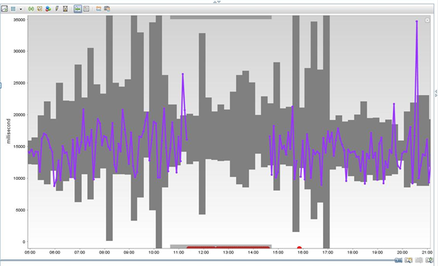
HP SHA proof point: predictive analytics
HP SHA predicts issue 60 minutes before it happened
Early morning: Metric performing within baseline
11:00am: Metric violates threshold
3
1
4
11:30am: Service now unavailable… standard monitoring generates alert
SHA detected problem and sent alert one full hour before the service failed!
Gray area: Dynamic threshold (baseline) created by SHA
2
10:30 am - SHA detects an anomaly and sends out an alert.
Footer goes here

Slide 11
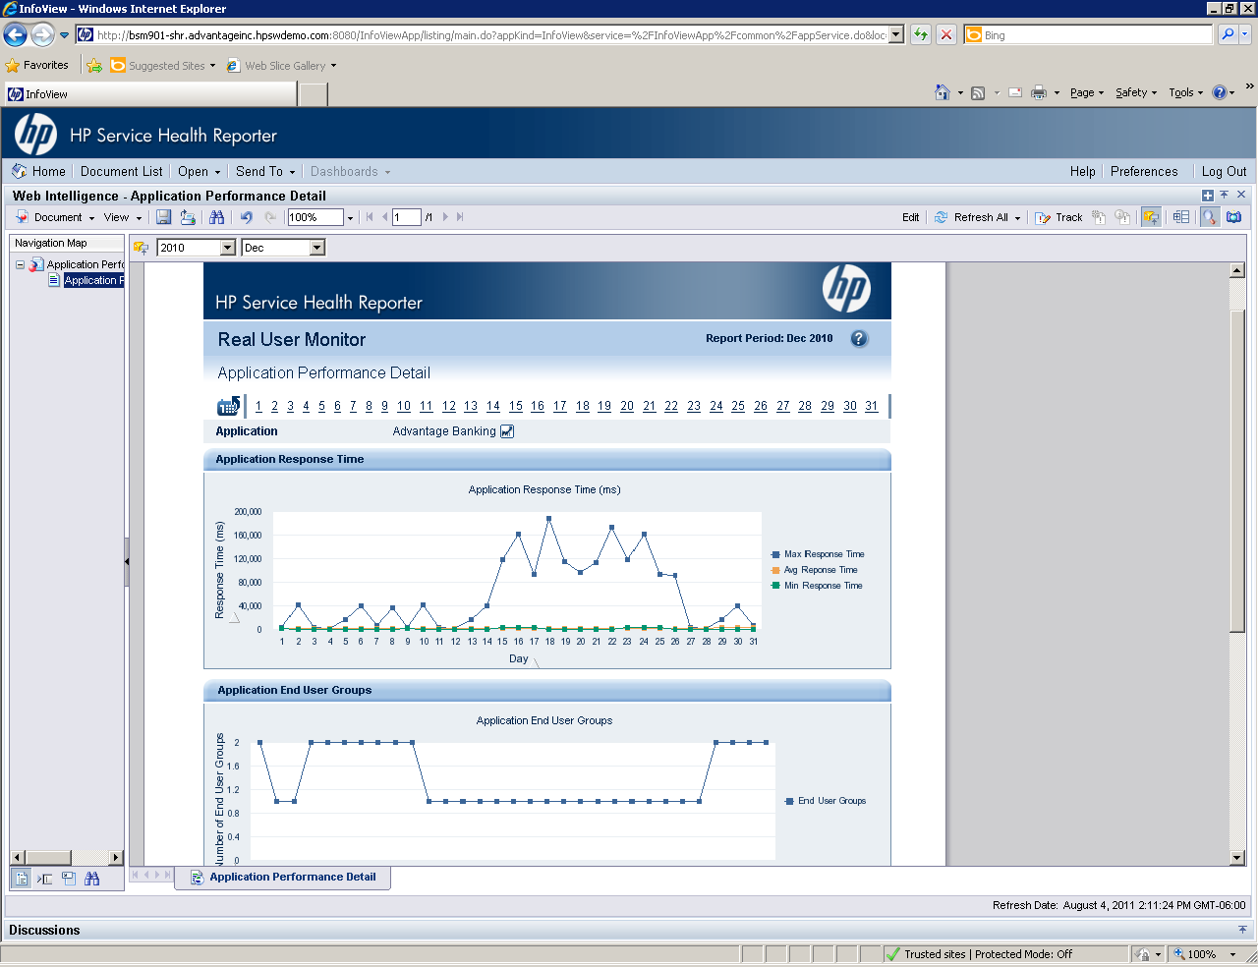
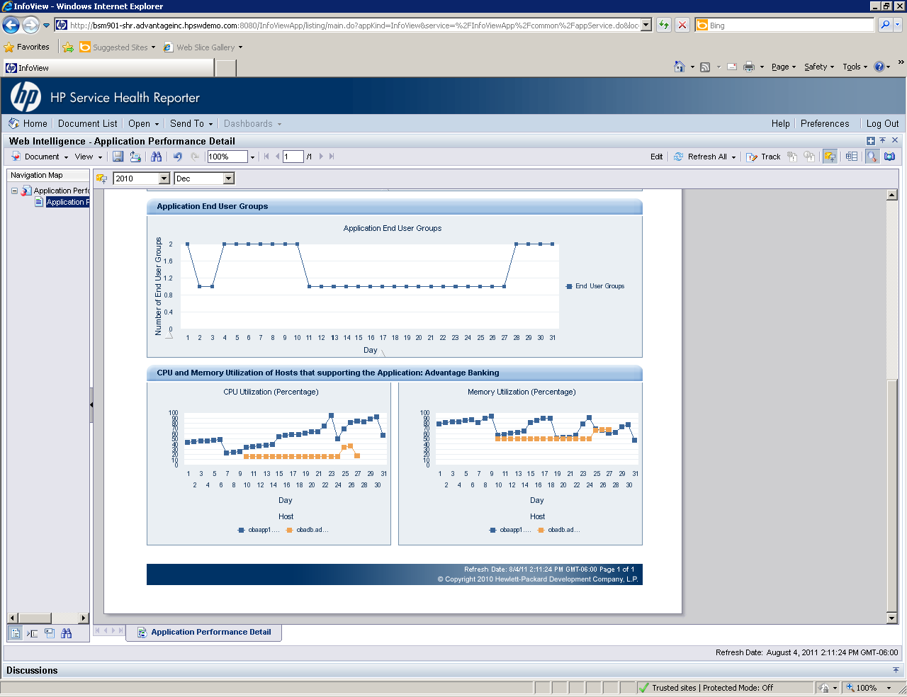
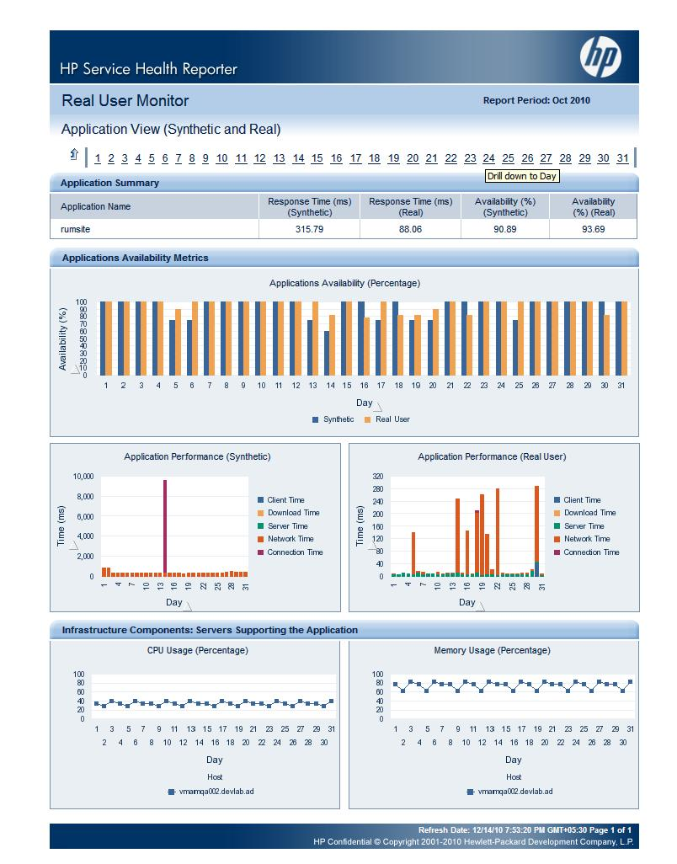
HP Service Health Reporter
Cross domain reporting tool to improve business service performance
Single screen tool - No more silos
Correlate the relationships between the Business Services and the infrastructure
Identify the changes in your dynamic, virtual environment
Forecasting of a specific metric or trend
Customizable reports to see what you want to see
Application metrics
Infrastructure metrics
RTSM as the foundation for integrating data
Notes:
You may be asking “Why do I need this when I have out-of-the-box reporting?”
The first reason is that SHR combines application metrics with infrastructure metrics. SHR links the end-user experience to the underlying infrastructure. In other words, you can see real user response time on your applications and tie it to the underlying infrastructure. You can also see response times, time stamp metrics, determine which hosts virtual machines reside on, and which VM host goes with which application.
and it holds data for longer periods of time.
SHR is also a cross-domain reporting tool. No longer are there silos when it comes to reporting! Cross-domain reporting allows you to make future decisions by seeing behavior patterns by topology, service, application, operating system, virtualization platform/technology like VMware, hypervisor, middleware, database, etc.
SHR also identifies the changes in your dynamic environment, allowing you to understand their impact to your business service.
SHR provides forecasting of specific metric or trend, ensuring you don’t hit performance issues against a specific metric (by CPU, memory, disk usage, service) for next say, 30-60-90 days.
While SHR provides many reports out-of-the-box, you can still customize reports. We all know that requirements change with time and context. How can I see just the stuff I want to see, just the way I want to see it? You can do that with SHR.
With SHR, you can make intelligent future decisions based upon historical patterns
Even create forecasting – Pure forecasting on specific metric or trend (linear). Very simple. You can forecast out to make sure you don’t hit performance issues again (of CPU, memory disk usage, for that service, for next 30-60-90)
You can drill down by time (year, month, day, hour) and across multiple domains (physical, virtual, application). Or you can see detailed metrics into a specific host.
Proof Point – One large pharma customer saw benefits of SHR within just 2 days of installing SHR. In that window, they identified a problem with a server that they were then able to go and correct for better utilization.

Slide 12
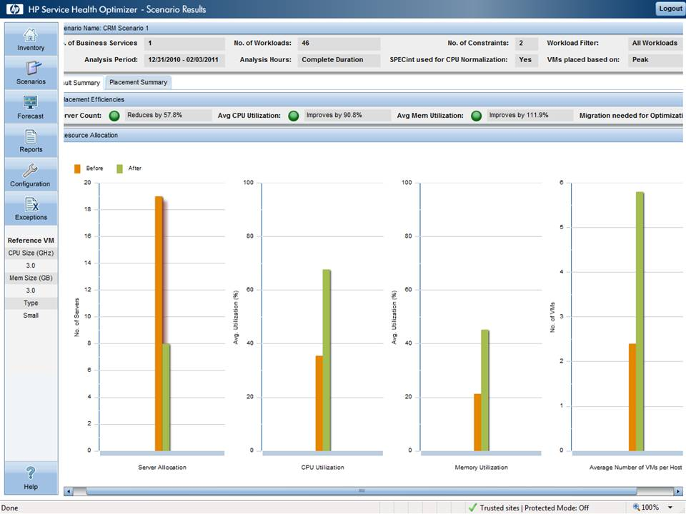
HP Service Health Optimizer
“Business service driven” capacity management for x86 virtualized environments
Visualize
What you have, what you use, and what can be improved
Optimize
Multi-dimensional, time-varying analysis
Forecast and Plan
What-if scenarios, trend analysis
ROI shown in optimization scenario: Server count reduced by 57.8%
Avg CPU utilization improved by 90.8%
Avg memory utilization improved by 111.9%
Notes:
Visualize
what you have, what you use, and what can be improved
Optimize
multi-dimensional, time-varying analysis
Forecast and Plan
What-if scenarios, trend analysis
(Tie back with audience’s need to manage virtualized environments.)
SHO is a must-have if you have a virtualized environment. It’s built on the RTSM, so its dynamic. Once you can visualize the environment, SHO will show you how to best optimize the environment … and do so with a click of a button!
Workloads are place, performance of virtualized environment?? and tie back to the application and business service. We show both infrastructure and the business service level.
With SHO, you can measure things like server count, average CPU, average memory, etc.
You can leverage SHO to achieve huge cost savings around reduced number of virtual machine licenses that you need … In the example above, SHO reduced the number of required virtual machines from 19 to 9, while maintaining the same service level. This translated into an annual license cost savings of $78,000!
Additional notes.
With the ease of provisioning new virtual systems, it becomes a challenge to know if you are over provisioning or underutilizing resources in private environments. To reduce costs, you need to use as much of the hardware capacity as possible. This requires having a tool that allows you to visualize, optimize, forecast and plan for virtualized environments. Service Health Optimizer provides a “business service-driven” capacity management for the virtualized environment.
There are 3 key aspects of this solution.
1 - Provides visibility into the physical & virtual server resources supporting a business service. Can also consolidate end user response time metrics for business services that have been gathered by HP BSM End user monitoring solution. This enables correlating resource utilization metrics with real world response time for a more comprehensive view.
Visualize
How much Capacity do I have and how much do I use?
Across datacenter, by Business Service, by cluster
Across Physical, VMware, Hyper-V resources
Does my infrastructure keep up with end-user response?
Do I have idle and powered-off VMs resulting in a VM sprawl?
Which servers are under or over-configured?
2 – SHO has an Optimizing engine that provides workload placement recommendations based on the resource utilization metrics. This is done using unique algorithms developed within HP labs.
Optimize
How do I place my VMs optimally in a server farm?
Are my VMs sized correctly?
What is the right VM size for my physical server?
Do I have enough headroom for unexpected spikes?
Will my new workload fit in my existing cluster?
3 – SHO Forecasts the remaining capacity, growth of VMs and allows what-if scenario analysis to predict the impact of workload or capacity changes.
Forecast and Plan
How much room for growth do I have?
Across datacenter, by Business Service, by cluster
When will I run out of capacity?
What-if I add or remove workloads?
What-if I add/modify/remove servers, memory, or CPU?
How is my datacenter usage projected to grow?
Should I buy server model A or model B?
SHO delivers fast time to value as it plugs into existing BSM solution.
Business Service Driven” Capacity Management for
Combines data from HP BSM collectors such as the Performance Agent and EUM with RTSM Topology data to create a unique and dynamic capacity planning capability

Slide 13
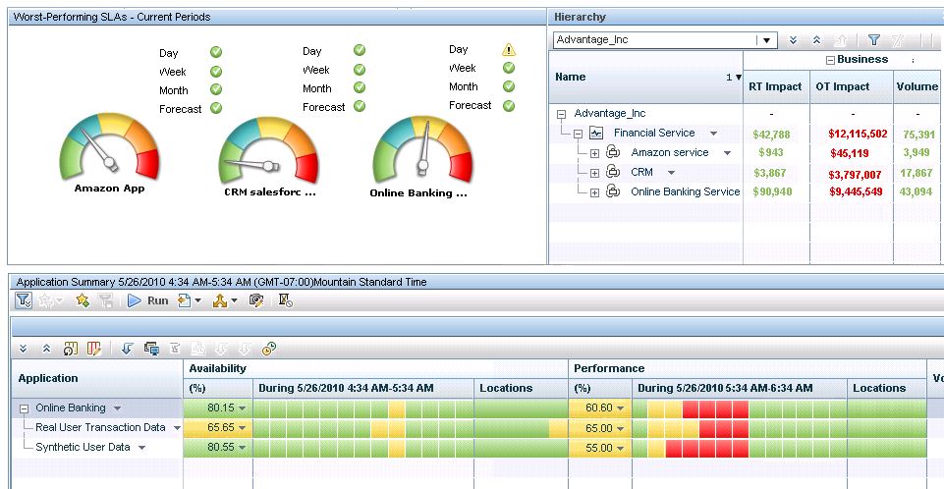
HP Service Level Management
Track and report application health and SLA’s in terms the business understands
Service level tracking
Business impact of affected service
Prioritize based on $ impact
Availability & performance over time
Use HP SLM to…
Show the health of the application
Track and report on business objectives and SLAs
See the monetary impact of issues
Single console to see the health of the service…on-site, off-site or in the cloud
Notes:
Use HP SLM to…
Show the health of the application
Track and report on business objectives and SLAs
See the monetary impact of issues
Single console to see the health of the service…on-site, off-site or in the cloud
Studies show that application performance issues impact revenue by up to 9%. (Source?)
Think about the Business Owners. They want to be able to track and report on business objectives and service levels. Is the application meeting the expectations of the users? What about my partners and suppliers?
The best way to report SLAs is in business terms. HP BSM’s dashboard shows the health of the business as well as the monetary impact of any issue to the business.

Slide 14
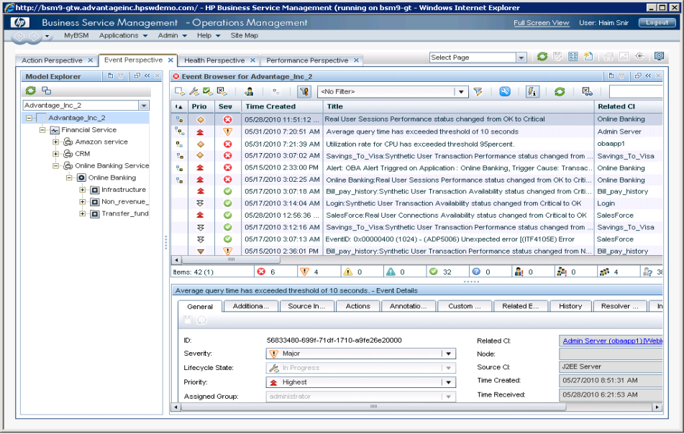
BSM integration with ArcSight
Integrate across business, operations, security & testing to increase IT efficiencies
Linking NOC and SOC
Operations Bridge
3
ArcSight Logger/ESM
Apps
Server
Storage
Network
IT Search for Ops
2
Logs for Ops
1
Applications
Web Traffic
Directory Services
Network Equipment
Virtual Infra
System Health Info
Physical Infra
Firewalls/
VPN
Intrusion Detection
Identity Mgmt
Anti-Virus
DBs
Notes:
Logs for Ops: End-to-end visibility: collect raw metrics from large and widely varied sources (300+ log sources) → improving automated operations
IT Search and intelligence analytics: report on application, server and network events from a single console → faster triage and diagnostics, compliance
Linking the NOC and SOC : using ops data to corroborate security incidents *and* using security information in triage and diagnostics for operations → breaking down organizational silos

Slide 15
Details on Executive Scorecard, Enterprise Collaboration, BSM Mobile

Slide 16
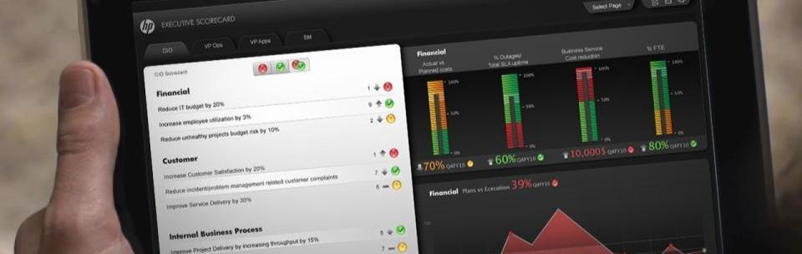
HP IT Executive Scorecard
Single pane of glass for IT performance with Industry’s broadest coverage of IT investment
Key performance indicators cascaded throughout the portfolio
Open data model and studio for KPI expansion and customization
Notes:
Providing a single pane of glasss into the HP IT Performance Suite is the HP IT Executive Scorecard released in July 2011 and shipping in most languages from Novmeber 2011.
The IT Executive Scorecard enables a persona-based cascading performance system for the IT leadership team, so the key performance indicators (KPIs) in a CIO’s scorecard can cascade down into meaningful KPIs their PMO/Finance head, VP of Ops, VP of Apps, CISO and VP of Information Management might then use to optimize performance at their levels.
The IT Executive Scorecard is built on HP’s open IT Data Model which contains the data model for the KPIs. Also the Scorecard includes a tool for managing data integration for HP or 3rd party products not already pre-integrated, using standard extraction, transformation and load (ETL) capabilities. More info is available in our IT Executive Scorecard presentation, data sheet and training materials.

Slide 17
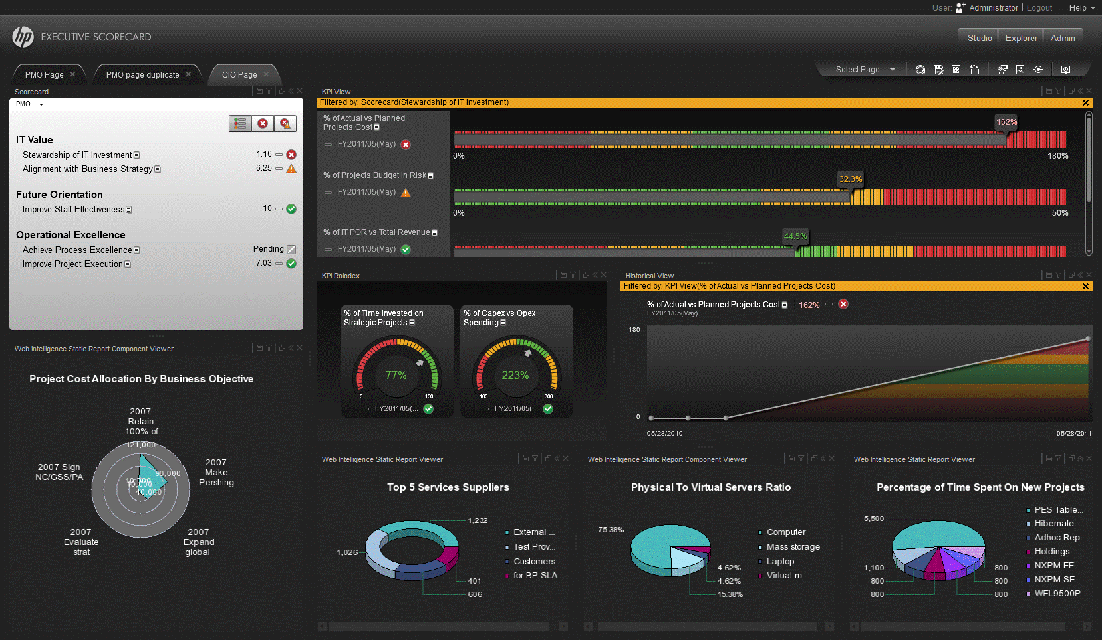
HP Executive Scorecard – VP Ops Edition
Automated Network Management
KPIs | Data Source
% of Compliant Data Center Network Devices | NA
% of Network Devices with Reachability Issues | NNM
% of Network Devices with Availability Issues | NNM
Average Network Events Backlog Size | NNM
% of Utilization of Network Devices | NNM
Average Throughput of Network Devices | NNM
Network Latency | NNM
Notes:
KPI Description for NA/NNM
% of Compliant Data Center Network Devices - Based on – resources assigned to current tasks, and their regional calendar which defines the expected working hours, holidays. We want avoid relating to resources that are in holiday.
% of Network Devices with Reachability Issues -The motivation for measuring this KPI is to get better insight to the overall reachability of the network devices. The assumption is that there is no tolerance for any network reachability outages as they might have impact on more than one service or application. Counts all unreachable network devices. Need to be measured by - Organization, Location, Provider - Network service provider\Vendors (Vodafone, ATT, Sprint - provide network. A NSP deliver network monitoring to several tenants), DataCenter LAN, Application, Services - infra services modeled in NMC
% of Network Devices with Availability Issues - The motivation for measuring this KPI is to get better insight into the overall availability of the network devices. It is required to measure the availability by planned and unplanned downtime Need to be measured by - Organization, Location, Provider - Network service provider\Vendors, DataCenter LAN, Application, Services - infra services modeled in NMC
Average Network Events Backlog Size -Measure the size of network related events. In case this number breaches a pattern over time it can imply that a change affected the networking management process
% of Utilization of Network Devices -This KPI measures the rate of utilization of network devices. In case the network devices aren't utilized enough It can imply a cost reduction opportunity. In case they are too utilized it can imply further investment is required. Compare by cost if possible. Need to be measured by - Organization, Location Provider - Network service provider\Vendors, DataCenter LAN, Application, Services - infra services modeled in NMC
Average Throughput of Network Devices – same as Average throughput of network devices Network Latency - High level reporting on the latency of the network Baseline performance anomalies (Latency should be in the context of location or data center
Trend of anomalies, Time to anomaly (days/hours until breach) Need to be measured by - Organization, Location, Provider - Network service provider\Vendors, DataCenter LAN, Application, Services - infra services modeled in NMC

Slide 18
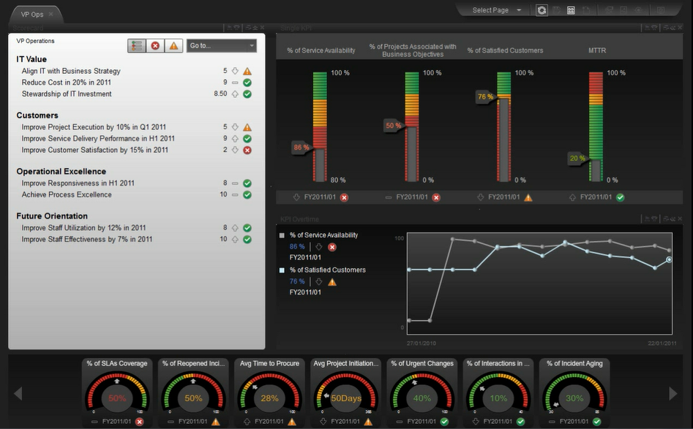
HP Executive Scorecard – VP Ops Edition
HP Business Service Management KPIs
20 BSM KPIs
  13 APM KPIs
  7 NNM/NA KPIs
1 view for Performance of IT Operations
Notes:
List of KPIs, total 20 KPIs from BSM feed into the VP Ops edition
% of Compliant Data Center Network Devices Based on – resources assigned to current tasks, and their regional calendar which defines the expected working hours, holidays. We want avoid relating to resources that are in holiday. NA
% of Network Devices with Reachability Issues The motivation for measuring this KPI is to get better insight to the overall reachability of the network devices. The assumption is that there is no tolerance for any network reachability outages as they might have impact on more than one service or application.
Counts all unreachable network devices. Need to be measured by - Organization, Location, Provider - Network service provider\Vendors (Vodafone, ATT, Sprint - provide network. A NSP deliver network monitoring to several tenants), DataCenter LAN, Application, Services - infra services modeled in NMC NNM % of Network Devices with Availability Issues The motivation for measuring this KPI is to get better insight into the overall availability of the network devices. It is required to measure the availability by planned and unplanned downtime Need to be measured by - Organization, Location, Provider - Network service provider\Vendors, DataCenter LAN, Application, Services - infra services modeled in NMC NNM Average Network Events Backlog Size Measure the size of network related events. In case this number breaches a pattern over time it can imply that a change affected the networking management process NNM % of Utilization of Network Devices This KPI measures the rate of utilization of network devices. In case the network devices aren't utilized enough It can imply a cost reduction oppertunity. In case they are too utilized it can imply further investment is required. Compare by cost if possible. Need to be measured by - Organization, Location
Provider - Network service provider\Vendors, DataCenter LAN, Application, Services - infra services modeled in NMC NNM Average Throughput of Network Devices Same as 519 NNM Network Latency High level reporting on the latency of the network
Baseline performance anomalies (Latency should be in the context of location or data center
Trend of anomalies
Time to anomaly (days/hours until breach)
Need to be measured by - Organization, Location, Provider - Network service provider\Vendors, DataCenter LAN, Application, Services - infra services modeled in NMC NNM % of Non-Encrypted Traffic Based on RUM captured data BSM % of applications availability Average availability measure for all critical apps
BSM % of Met Application Performance Average performance measure for all critical apps BSM % of Failed Transactions Failed transactions in all critical apps out of the total transactions BSM % of Affected Sessions How many users had been affected from application faults out of the total users in a given time period BSM % Monitored Applications % of business apps which are monitored out of total apps BSM % of Business Applications Covered by an SLA % of business apps which are part of an SLA contract BSM % of Applications With Met SLA % of business apps which met SLA contract BSM % Availability Improvement After a Change following modernization/transformation, How much the availability been improved due to a change in comparison to the state before a change (for example moving to cloud)
BSM % Performance improvement after a change How much the performance been improved due to a change in comparison to the state before a change BSM % Usage improvement after a change How much the usage volume been improved due to a change in comparison to the state before a change (mainly can be relevant to marketing and advertising promotions) BSM Application Cost per User Aggregate measure of cost for applications and their supportive infrastructure normalized by the number of users (usually for benchmarking purposes) BSM Application ROI app utilization with respect to application investment/Cost BSM

Slide 19
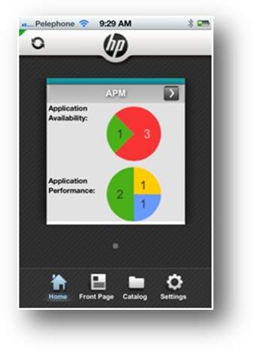
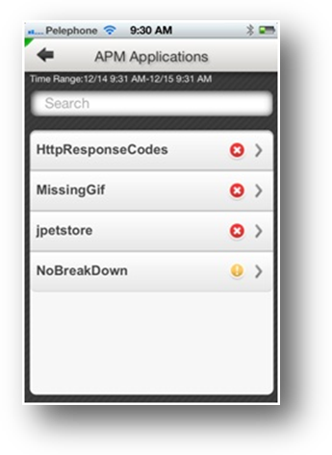
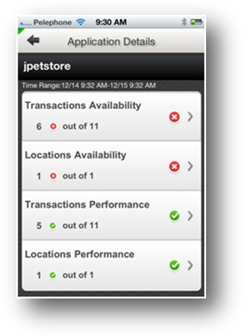
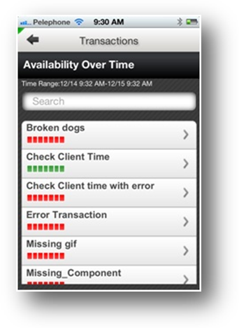
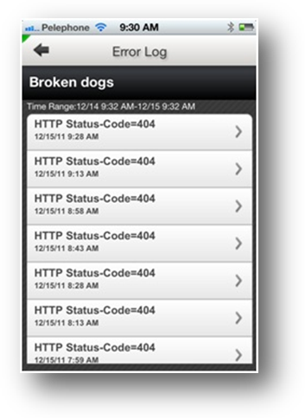
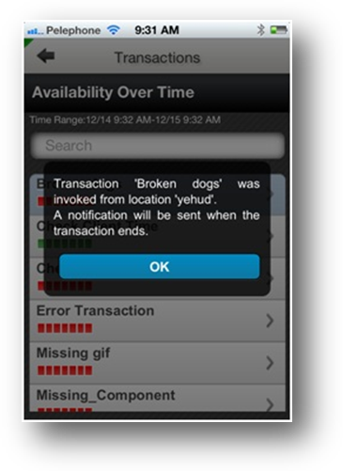
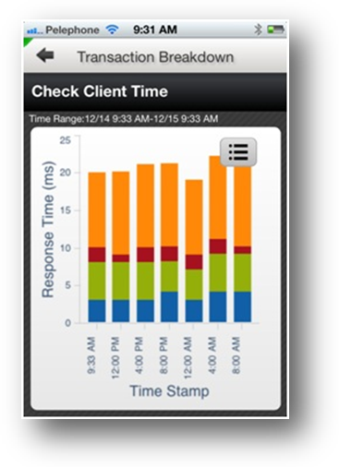
HP Anywhere - BSM on your mobile device

Slide 20
Thank you

Slide 21

Vodafone Ireland
Journey to Operational Excellence
IT Improvements
66% reduction in customer impact
28% reduction in number of major incidents
77% reduction in cumulative monthly downtime
Initial Challenge:
Reactive, introspective, fragmented IT operations process
Solution:
HP Business Service Management 9.1
(APM, OMi, DDMA, ArcSight Logger)
Business Benefits
IT resources are more closely aligned with business needs
IT better supports the business’ ability to improve customer retention, drive market growth and manage overhead costs
Cost savings €1.2 in one year, 300% ROI
Notes:
From Vodafone Ireland Case Study:
Objective:
Replace reactive, introspective, fragmented IT Operations processes with a more effective management framework
Approach:
Implement integrated, end-to-end IT management solution framework to deliver and track measurable business services with quantifiable benefits
IT improvements:
Major incident root cause identification success rate improved from 40% to 90%, contributing to 66% reduction in average time customers are impacted by IT incidents every month, 28% reduction in number of major incidents, 75% reduction in major incident service restoration times, and 77% reduction in cumulative monthly service downtime
Business benefits:
IT resources and priorities more closely aligned with business needs, which better supports the business’ ability to improve customer retention, drive market growth, and manage overhead costs
Online services able to discontinue use of a third party services monitoring tool, reducing monitoring costs by €60,000 annually
Customer solution at a glance
Primary application
Business Service Management
Primary software
HP IT Performance Suite — IT Operations Management
HP Business Service Management (BSM) 9.0
HP Application Performance Management (APM)
HP Operations Manager i (OMi)
HP Discovery and Dependency Mapping Advanced Edition (DDMA)
HP ArcSight software
Pull quotes:
“Our HP Business Service Manager solutions have helped us transform from a reactive to a proactive IT organization, and to align our priorities to match the business and drive business value.”
Shane Gaffney, head of IT Operations, Vodafone Ireland
“Historically, our technology teams knew when technology needed to be upgraded, but found it difficult to communicate those needs in language the business could understand. Today, we’re able to construct cohesive arguments based on the business benefits of technology improvements. As a result, we’ve found the business to be extremely receptive to all of our budget requests.”
Shane Gaffney, head of IT Operations, Vodafone Ireland
“HP OMi is our top level platform. It brings everything together in a browser and generates alerts based on both system health and security issues.”
Karl Brenner, director of Professional Services, Perform IT
Tagline – Microsoft is a trademark of the Microsoft group of companies.
See my spreadsheet and e-mail regarding where to look in the spreadsheet

