Slide 1
OMi CiGenerator tool
this tool was introduced with BSM 9.23

Slide 2
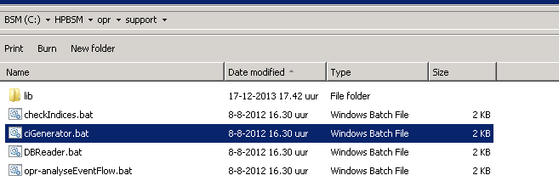
  Overview of the CiGenerator tool .
The tool is located in the ..:\HPBSM\opr\support directory :

Slide 3
Run the tool with –h to see all of its options.
..:\HPBSM\opr\support>cigenerator -h
Usage: ciGenerator -h | -file <file> [-customer <id>] [-start <start>] [-count
<count>] [-v]
This tool is to be used only for testing purposes by HP Support.
This tool helps generate one or several CIs and relations in UCMDB.
-c,-counter <counter> Counter to set multiplicity. <count> will
determine how many CIs of the same type to
create.
-customer <customer> Customer ID
-f,-file <file> CI descriptor filename in XML format. See
example below
-h,-help Help
-s,-start <start> Start identifier to be replaced in XX suffix.

Slide 4
Please note: This tool is to be used only for testing purposes by HP Support.
This tool helps generate one or several CIs and relations in UCMDB.
The CI and relation candidates are imported from an xml descriptor file.
We will use the provided example to see what actually happens and what will be added to the RTSM.
<?xml version="1.0" encoding="UTF-8"?>
<cis>
<ci name="testnode1" type="nt">
<attribute>name=testnode1_XX</attribute>
<attribute>primary_dns_name=hostname1_XX</attribute>
</ci>
<ci name="testnode2" type="unix">
<attribute>name=testnode2_XX</attribute>
<attribute>primary_dns_name=hostname2_XX</attribute>
</ci>
<ci name="testDisk" type="file_system">
<attribute>name=testDisk</attribute>
<attribute>root_container=testnode1_XX</attribute>
<attribute>mount_point=/</attribute>
</ci>
<rel type="composition" source="testnode1" target="testDisk"/>
</cis>
The suffix 'XX' will be replaced with numbers indicated in <start> and <count> arguments

Slide 5
Let’s take the example…
The XML of the example will create two Ci's of the "testnode" Ci type.
"testnode1" will have as OS type "nt" and "testnode2" will have "unix" as Ostype,
the "nt" nodes will be called "hostname1_xx, and will have their subsequent number assigned to it.
We will create 5 "nt" nodes, so their names will be hostname1_01, hostname1_02, hostname1_03, etc
For Unix types of nodes, the names will be hostname2_01, hostname2_02, hostname2_03, etc
"testnode1" will be a container for the Ci "testdisk" which will be created as well.

Slide 6
How will this example result as real test, if we would like to create 5 (test) CI’s, following the example. The first node should have the number “01” and the last one “05”. We will go throught the options one by one.
ciGenerator -file <file> : we will use the attached example-cigenerator.xml
-customer <id> : this is “1” (one)
-start <start> : the start identifier, it will be “01” in the example
-count <count> : the number of CI’s to be created. We will create 5 CI’s.

Slide 7
Now, adding all the options together on in one command line:
Cigenerator –file example-cigenerator.xml –customer 1 –start 01 –counter 5
Which results in the following command line output, from the BSM server:
INFO: Parsed 3 CI and 1 relation descriptions to import
INFO: Connected to UCMDB
INFO: Successfully created CIs from descriptor file

Slide 8
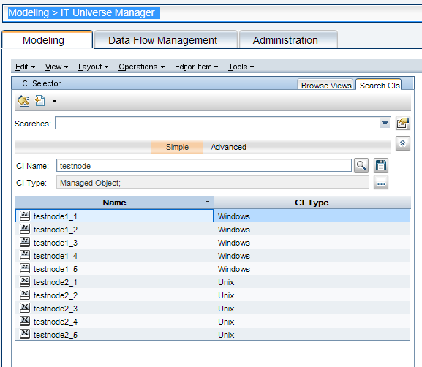
Now, login to BSM and check the RTSM what has been created there. Go to Admin > RTSM administration > IT Universe Manager, and look for CI name “tesnode”. It should give the following results:

Slide 9
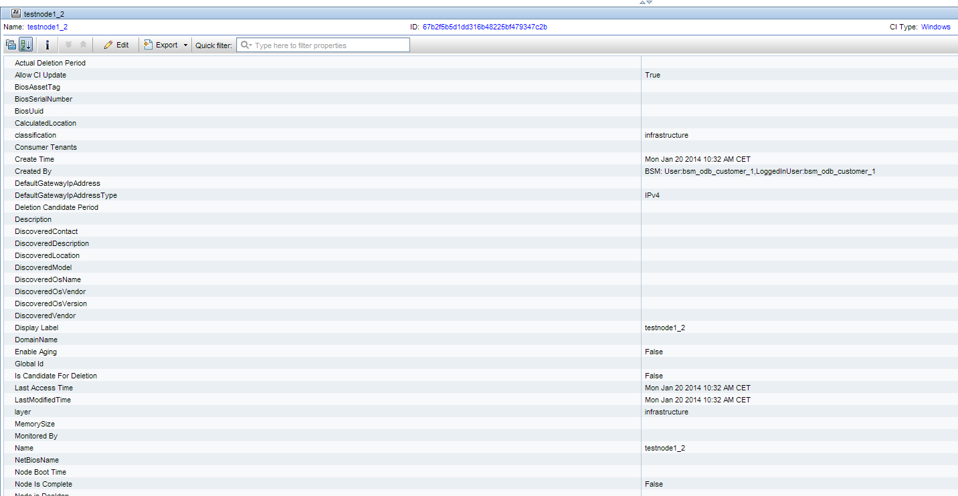
When checking the CI details, it will show the following :

Slide 10
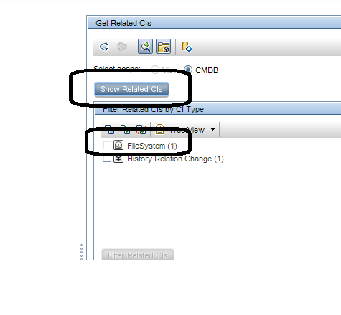
When clicking on “show related Cis” on the right pane will show the Filesystem and testdisk CI’s.

Slide 11
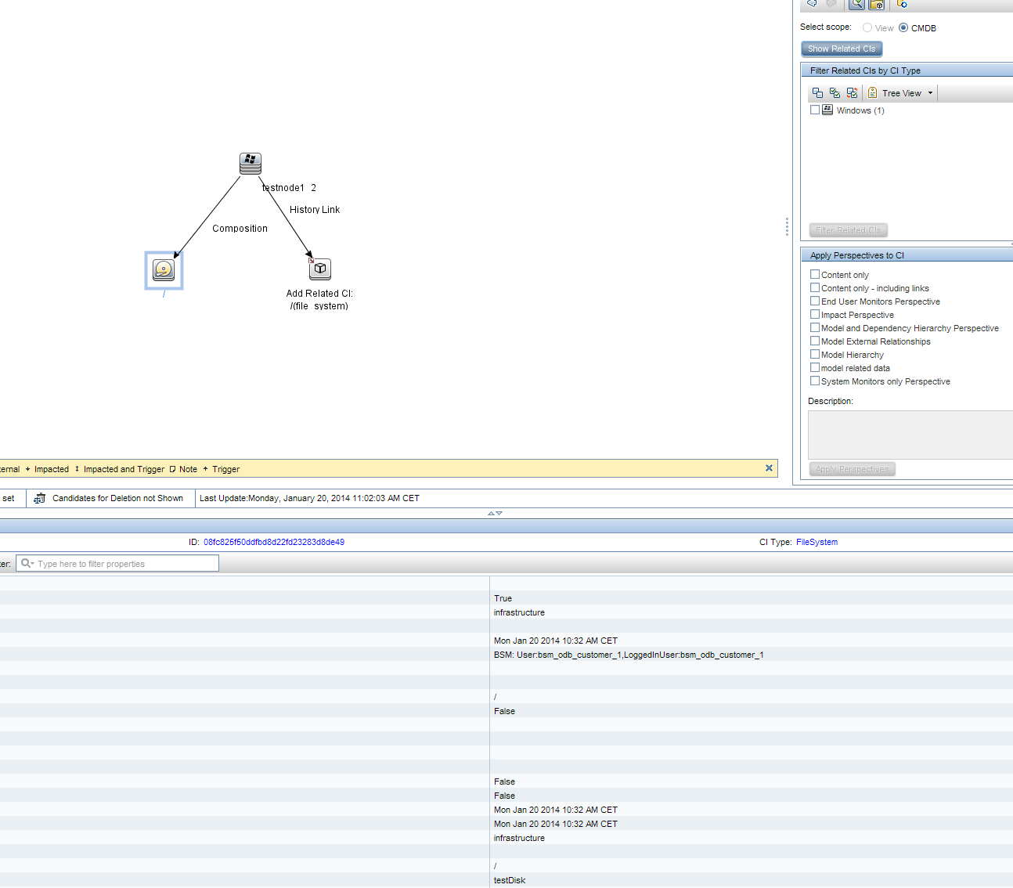
The testnode child CI’s will be shown .

Slide 12
The Filesystem attribute and testdisk were only created for NT CI types, why?
Because the XML specified as root container, the “testnode1_xx” so they were only created for nt nodes :
<attribute>root_container=testnode1_XX</attribute>

Slide 13
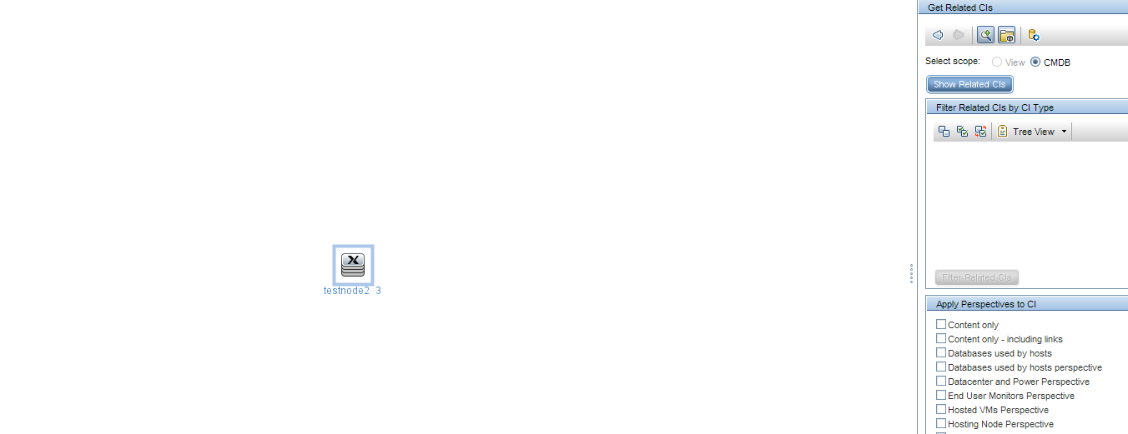
We can see this when clicking on “show related Cis” for one of the “unix” test nodes.

Slide 14
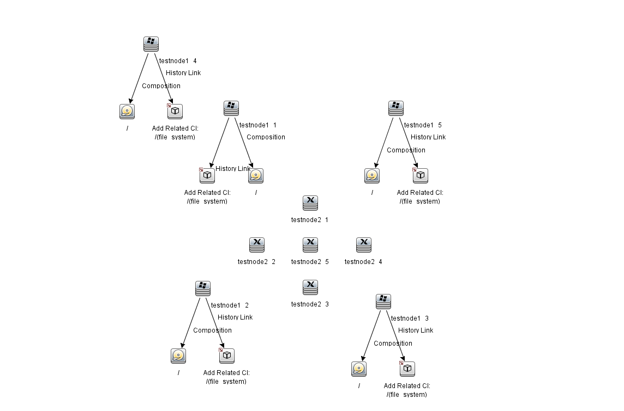
The overall picture shows all the nodes created and their attributes, the unix ones do not have any child CI’s.

